Slide 1
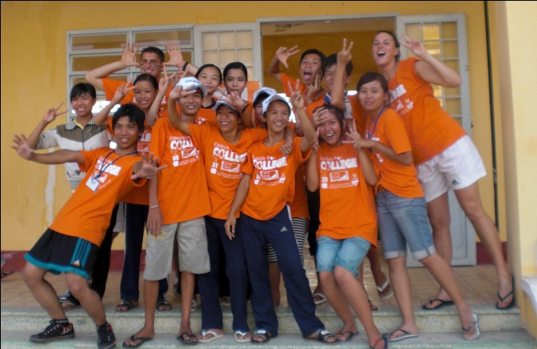
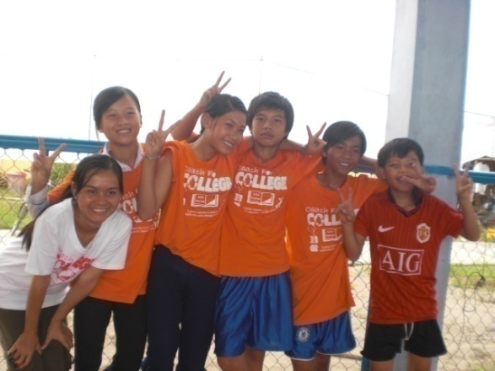
Session 4: School and teaching

Slide 2
Agenda
Background on Vietnamese Education and Sports | 3
Role of Leadership During Each CFC Camp | 4
Tour of the Host School: Hoa An | 5
Lesson Plans and Student Versions | 6
Academic and Life Skills Tests | 7
Next Steps | 8

Slide 3
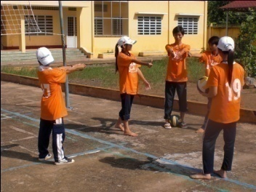
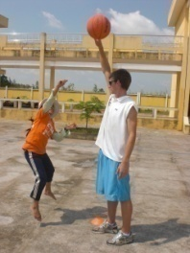
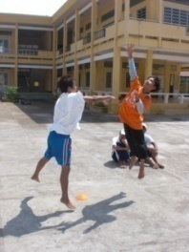
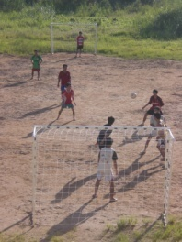
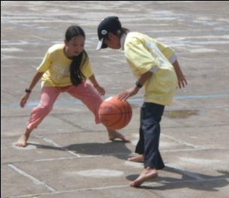
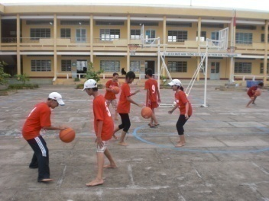
Background on Educations and Sports: Sports Participation
While most of the students have engaged in some form of sporting activity, a majority do not participate in sports frequently
Typical Participation
Community Impact
Sports in Vietnam are becoming increasingly popular at a grassroots level.
In many parts of Vietnam, particularly in rural areas, people cannot afford to buy sports equipment.
As a result, the only people who participate extensively in sport are those who can afford to pay the rental fees required to use sports facilities. However, there are very few of such facilities in rural areas.
There are no recreational sports leagues during the year, involving competitions between different schools.
There also are no sports leagues at the community or university level in Vietnam.
Kids tend to teach themselves sports and do not have formal training.
% of Students who play sports on a typical day
10%
8%
During School
During Summer
86% of participants indicated they plan to use the sports court built by the program frequently or sometimes, reporting that they will do so about 4 days per week on average
Notes:
Typical Participation:
Sports in Vietnam are becoming increasingly popular at a grassroots level.
In many parts of Vietnam, particularly in rural areas, people cannot afford to buy sports equipment.
As a result, the only people who participate extensively in sport are those who can afford to pay the rental fees required to use sports facilities. However, there are very few of such facilities in rural areas.
There are no recreational sports leagues during the year, involving competitions between different schools.
There also are no sports leagues at the community or university level in Vietnam.
Kids tend to teach themselves sports and do not have formal training.
Community Impact:
Low current participation in sports:
8% play sports during the school year
10% play sports during the summer
Favorite Sports:
Badminton – 47%
Soccer – 39%
Volleyball – 15%
Extensive use of the sports court:
86% of participants indicated they plan to use the sports court built by the program frequently or sometimes, reporting that they will do so about 4 days per week on average

Slide 4
Role of Leadership During Each CFC Camp
Several CFC staff will be onsite, helping to oversee all aspects of the camp and to ensure your effectiveness and wellbeing. At each site, there is one Program Director and one Assistant Director. Within most camps, there are two College Directors (1 U.S., 1 VN).
American College Directors
Health & Safety Coordinator
“Team captain” of the American coaches
Serve as a liaison between American student-athletes/Vietnamese college students and all others involved in the program
Help American coaches successfully adjust to the food and living conditions at the camp site
Lead nightly meetings with American student-athletes and Vietnamese coaches and give daily feedback to college student coaches about how to improve their coaching and teaching. Facilitate reflection sessions.
Ensure American students’ behavior is in line with program policies
Seth Napier
Monitors health and safety aspects of camps
Point person for resolving any illnesses or injuries, major or minor
Assists in any crisis which may arise (health, family, etc)
Helps smooth any interpersonal, intercultural or other issues.
Program Director
One per site
Vietnamese leader of Program at a Given Site
Supervises both College Directors
Ensures program at a given site run smoothly and mitigates any issues that arise
Vietnamese College Directors
“Team captain” of the Vietnamese coaches
Help Vietnamese coaches successfully adjust to the camp schedule and the program’s methodology and curriculum
Ensure the Vietnamese college students have a good experience and interact well with the American coaches
Intervene as necessary to solve behavioral problems that arise during the camp
Help lead camp-wide activities such as team building relays and plays a large role in organizing and directing Competition Days
Site assistant
One or two per site
Help coordinate various camp logistics (sports equipment, transportation, tests, etc.)
Most are past VN coaches who want to remain involved with the kids and the program

Slide 5
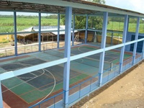
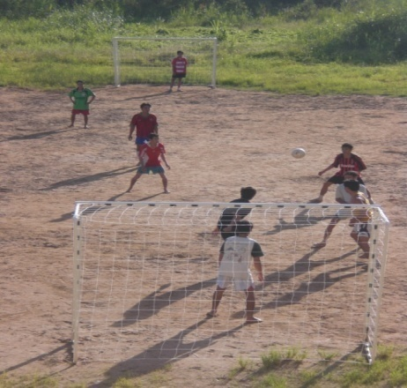
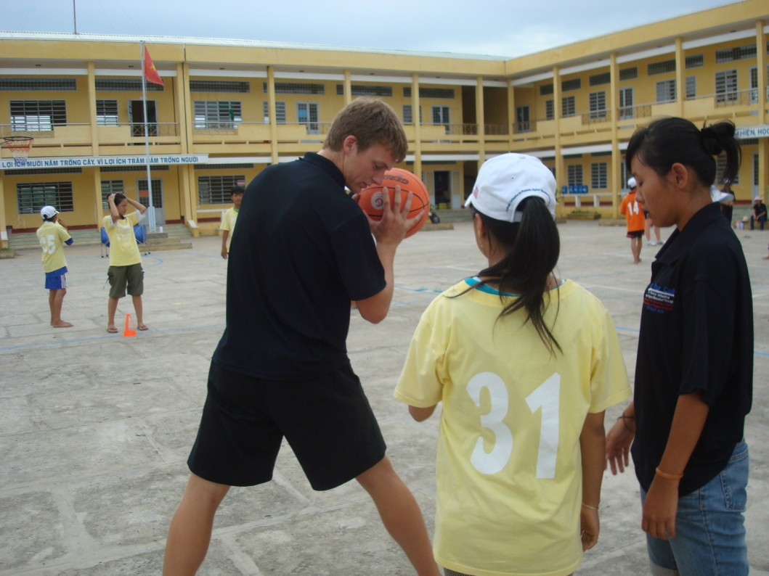
Tour of one of the Host Schools: Hoa An (in Hau Giang Province, Mekong Delta)
CFC uses different parts of the partner middle school for each component of the camp.
All the Soccer Classes take place on the soccer field at the school
All the Tennis Classes and many of the Sports Competitions take place on the sports court
Academic Classes take place on the second floor of the school
Life Skills Classes take place in the Team Rooms on the first floor of the school
Equipment Room is on the first floor next to the stairs
Basketball and Volleyball Classes take place on the central courtyard of the school

Slide 6
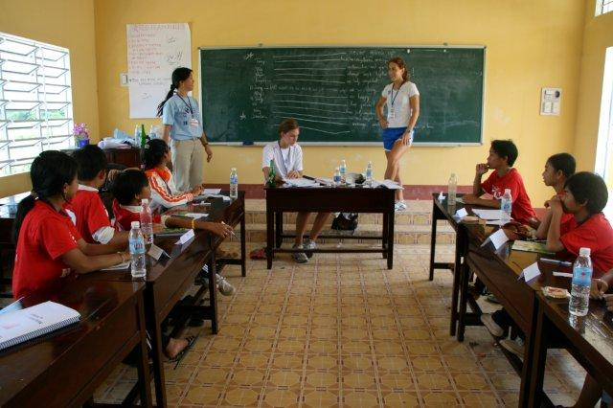
Lesson Plans and Student Versions
Coaches are given lesson plans for each Academic and Life Skills class. The middle school students have workbooks containing “student versions” of these lesson plans.
Lesson Plans
You will be provided with a detailed lesson plan for your academic subject.
This lesson plan includes the topics for each class, as well as example practice problems, games and exercises that you can do in order to practice these concepts.
The lessons act as a guide, but many of the activities included have come from ideas that past coaches have had to make the lesson more alive and interesting. We encourage you to use any creative approaches you wish to modify the lesson.
Student Versions
The students will all have printed manuals that include sections for each academic subject as well as the life skills subjects.
They will take notes directly into these manuals, and will also perform exercises in these manuals.
We encourage the students to take the workbooks home everyday and study them before the tests.
Notes:
Lesson Plans:
For your academic subject, you will be provided with a detailed lesson plan
This lesson plan includes the topics for each class, as well as example practice problems, games and exercises that you can do in order to practice these concepts
The students will be tested at the end of each week on what they learned in each subject.
The information is written at a college student level. Part of your role will be to simplify the concepts for the kids so that they understand
The lessons have been selected because they contain a particular lesson from the relevant Vietnamese textbook which can be related to sports. Thus there may not be a natural progression of topics in the way there would if the curriculum were designed from scratch
We are trying to teach students in advance material they will cover during the next school year, so many of the concepts will be new to them
There are more concepts and activities than can be covered in 45 minutes. Part of your role will be to pick and choose the most important concepts and activities, and point out where students can read in more detail about a given topic at home
In the lesson planning meetings each time, set time limits for each topic so you make sure you cover what you want to cover during the time allotted
Student Versions:
The students will all have printed manuals that include sections for each academic subject as well as the life skills subjects
They will take notes directly into these manuals, and will also perform exercises in these manuals
We encourage the students to take the workbooks home everyday and study them before the tests.

Slide 7
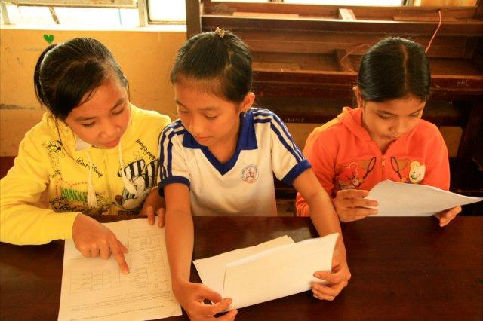
Academic and Life Skills Tests
Coaches are given lesson plans for each Academic and Life Skills class. The middle school students have workbooks containing “student versions” of these lesson plans.
Academic Tests
Academic tests are administered on each Friday.
You will be given the questions ahead of time, in order to check that they correspond well with what you covered.
The students are tested on the concepts learned that week in all four academic subjects.
The Directors and Coaches will score the tests after they are taken – the collective team scores are then used to determine the number of points earned for each class.
Life Skills Tests
Life Skills tests are administered on each Friday.
The students are tested on the concepts learned that week in Team Building/Leadership and Higher Education.
The Directors and Coaches will score the tests after they are taken – the collective team scores are then used to determine the number of points earned for each class.
Notes:
Academic Tests:
Academic tests are administered on each Friday
You will be given half of the questions ahead of time to give you an idea of what the test will cover
The students are tested on the concepts learned that week in all four academic subjects
The Directors and Coaches will score the tests after they are taken – the collective team scores are then used to determine the number of points earned for each class
Life Skills Tests:
Life Skills tests are administered on each Friday.
The students are tested on the concepts learned that week in Team Building/Leadership and Higher Education.
The Directors and Coaches will score the tests after they are taken – the collective team scores are then used to determine the number of points earned for each class.

Slide 8
Next Steps
Continue Fundraising
Has everyone had a visit at travel clinic and received pre-trip vaccinations and prescriptions? If not, make that a top priority!
Everyone who was renewing passports should have received those and submitted a digital copy of the picture page. If your passport expires less than 6 months before you return from Vietnam and you have not already applied for a new one, contact CFC right away!

