Slide 1
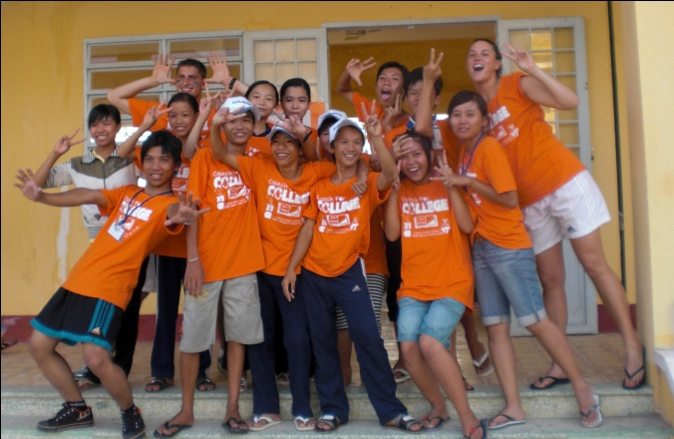
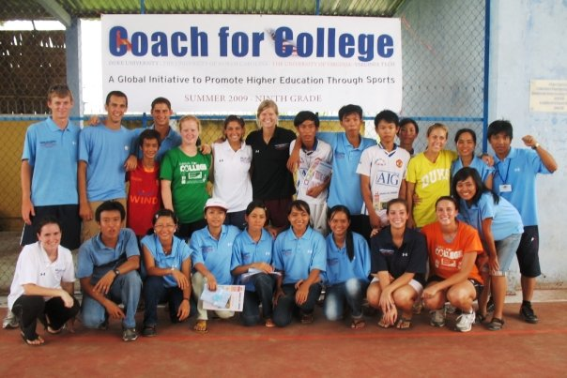
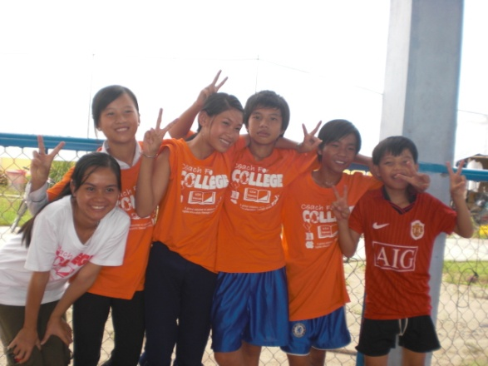
Session 2: Preparing to Live

Slide 2
Agenda
Geography of Vietnam | 3
Living Conditions and Food for Coaches | 6
Safety and Security | 7
Maintaining Good Health | 8
Money and Finances | 9
Communication Back Home While in Vietnam | 10
Next Steps | 11

Slide 3
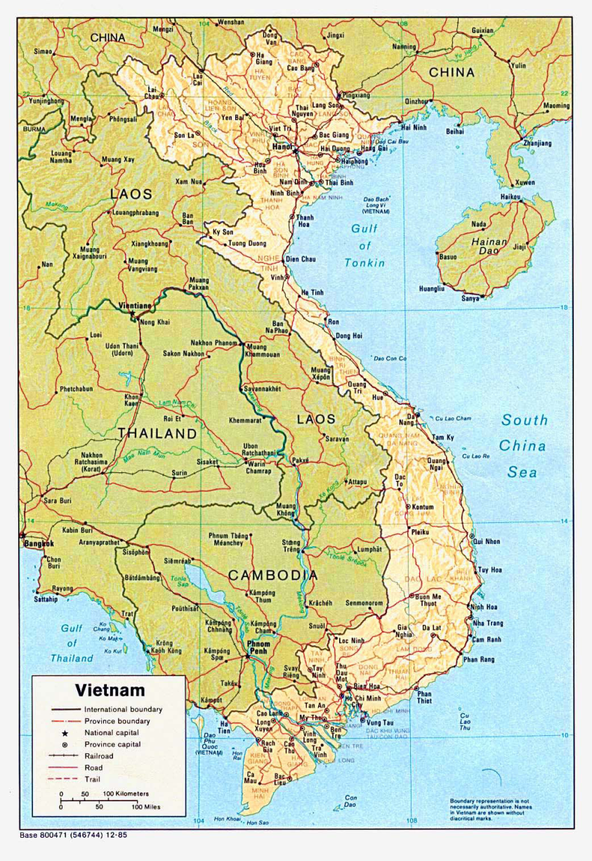
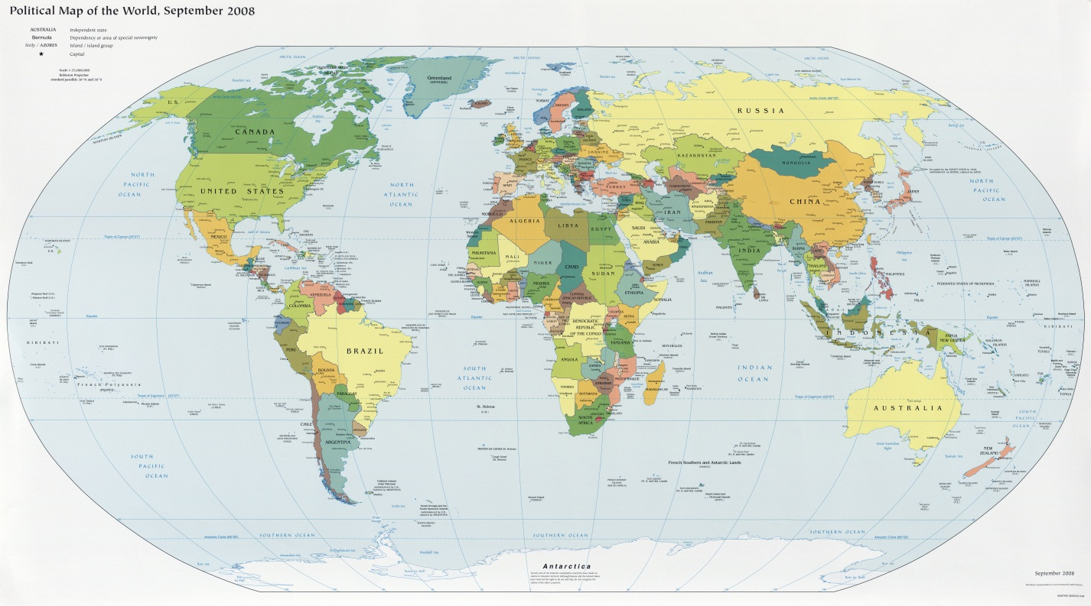
Geography of Vietnam: Overview
Vietnam is located in Southeast Asia, bordering China, Laos and Cambodia. It stretches 1000 miles from north to south as the crow flies (1500 miles by road) and ranges in width from 30-370 miles.
Capital: Hanoi
Population: 88 million
Average per capita income: $550/year
Major industry: agriculture
Hanoi
Red River Delta
Ho Chi Minh City
Can Tho
Mekong Delta
Notes:
Vietnam is located in Southeast Asia, bordering China, Laos and Cambodia. It stretches 1650 km from north to south and ranges in width from 50-600 km.
The capital is Hanoi, located in the north of the country (population 3.1 million)
Ho Chi Minh City, or Saigon, is Vietnam’s largest city (population 6.2 million) and is the most rapidly developing city in the country
Contains 88 million people, 74% of which live in rural areas; 54 different ethnic groups
Over half of the people are under 25 years old
2/3 of the population earns their living from agriculture
The average per capita income is about $550/year, though many survive on less than 50 cents/day
Vietnam is an agricultural country which has two large regions of fertile soil, the Mekong Delta in the South and the Red River Delta in the North
Vietnam is the world’s second largest rice exporter after Thailand
The country is mountainous in the northwest and in the central highlands facing the South China Sea, with peaks reaching up to 8000ft (2450m)

Slide 4
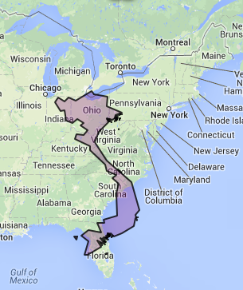
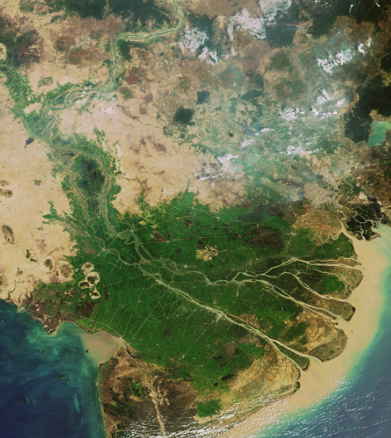
Size of Vietnam, relative to United States

Slide 5
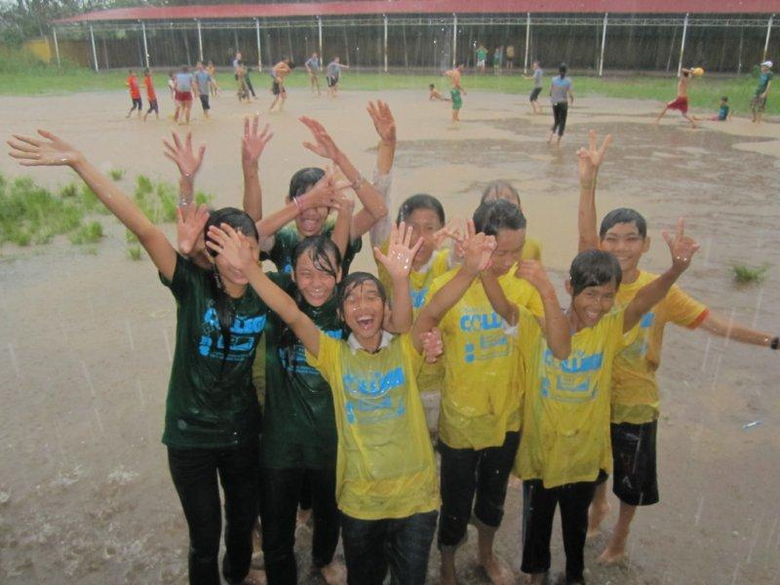
Geography of Vietnam: Climate and Weather
Rain
Vietnam has a tropical monsoon type of climate
Vietnam has a single rainy season during the south monsoon (May-Sept)
Temperature
Temperatures are high all year round for southern and central Vietnam
Ho Chi Minh City
Month | Rainfall (mm) |  | Temperature (Fahrenheit)
 | Average monthly | Ave no of days with 1mm | Average daily |  | Lowest recorded | Highest recorded
 |  |  | min | max
Jan | 14 | 3 | 69.8 | 89.6 | 55.4 | 98.6
Feb | 4 | 2 | 71.6 | 91.4 | 59.0 | 100.4
Mar | 12 | 2 | 73.4 | 93.2 | 66.2 | 102.2
Apr | 42 | 5 | 75.2 | 93.2 | 68.0 | 104.0
May | 220 | 15 | 77.0 | 91.4 | 69.8 | 102.2
Jun | 331 | 22 | 75.2 | 89.6 | 71.6 | 100.4
Jul | 313 | 23 | 77.0 | 87.8 | 68.0 | 95.0
Aug | 267 | 20 | 75.2 | 89.6 | 66.2 | 93.2
Sep | 334 | 21 | 73.4 | 87.8 | 69.8 | 95.0
Oct | 268 | 20 | 73.4 | 87.8 | 68.0 | 93.2
Nov | 115 | 12 | 71.6 | 86.0 | 64.4 | 95.0
Dec | 56 | 8 | 71.6 | 87.8 | 59.0 | 96.8
Notes:
It has a tropical monsoon type of climate
From May-Sept. the south monsoon sets in
From Oct-April, the north monsoon is dominant
Vietnam has a single rainy season during the south monsoon (May-Sept), during which rainfall is abundant, with annual rainfall exceeding 1000 mm almost everywhere
Annual rainfall is even higher in the hills, especially those facing the sea, in the range of 2000-2500 mm
Rainfall is infrequent and light during the rest of the year
Temperatures are high all year round for southern and central Vietnam
Northern Vietnam has a definite cooler season as the north monsoon occasionally brings cold air in from China
In southern Vietnam, the lowlands are sheltered from outbreaks of colder northerly air and the dry season is warm to hot with much sunshine.

Slide 6
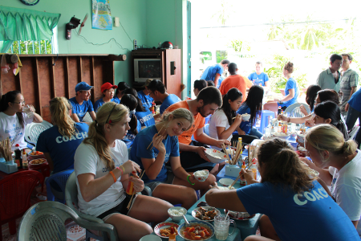
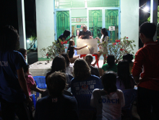
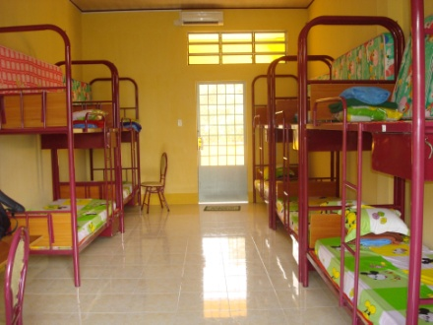
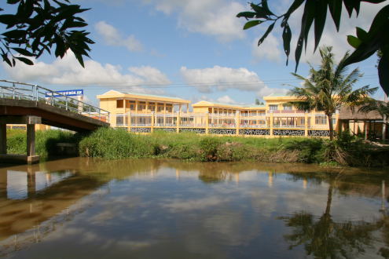
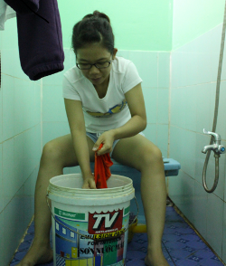
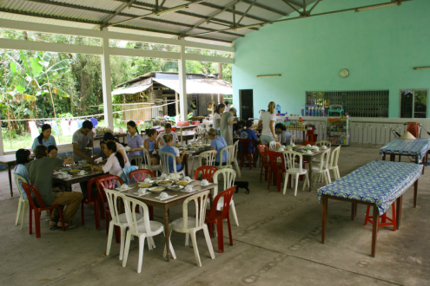
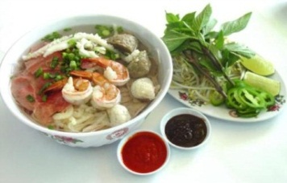
Living Conditions and Food for Coaches
Lodging
Coaches will stay at a guest house in 2-3 person rooms (mixed US and VN coaches)
The partner middle school is located a few kilometers away from the lodging
http://www.mediafire.com/?349d5zv0xy7xl0p and click green download button (Hoa An room)
Sleeping Arrangements
Rooms will be divided by gender
Western style toilets will be available at the guesthouse (with squat toilets at the school)
The beds have mattresses with a fleece blanket and mosquito nets, a fitted bottom sheet, but no top sheet.
Food
Food offered during the program will be Vietnamese style
Vietnamese food is always fresh, often bought the same morning straight from the market
A famous dish in Vietnam is phở (pronounced a bit like “fur” with an English accent)
Notes:
Lodging
Hoa An coaches will stay at the research center
Thuan Hung coaches will stay at guest homes in groups of 2-3 people
Coaches will stay in dorm-style residence rooms
The partner middle school is located a few kilometers away from the lodging
Sleeping Arrangements
Rooms will be divided by gender
Westernized toilets will be available
There is no hot water, though the cool water feels great at the end of the day
The beds have mattresses with a fleece blanket on top
Pillows are small and hard compared to the norm in the U.S., so it is highly recommended that you bring your own pillow
You will probably also want to bring your own sheets
Mosquito nets will be provided
Food
Food offered during the program will be Vietnamese style – appropriately.
In general the food in Vietnam is good
You should bring whatever American food you think you need, however one good principle of cross-cultural programs is to eat what your hosts eat – it’s a form of acceptance and engagement.
Steamed white rice is served with every meal
One of the characteristics of Vietnamese food is that it is always fresh, being bought the same morning straight from the market.
A famous dish in Vietnam is pho (pronounced “fur”), a noodle soup eaten at any time of day but mainly at breakfast

Slide 7
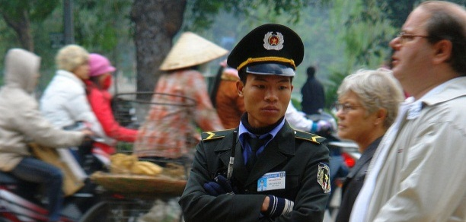
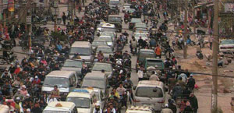
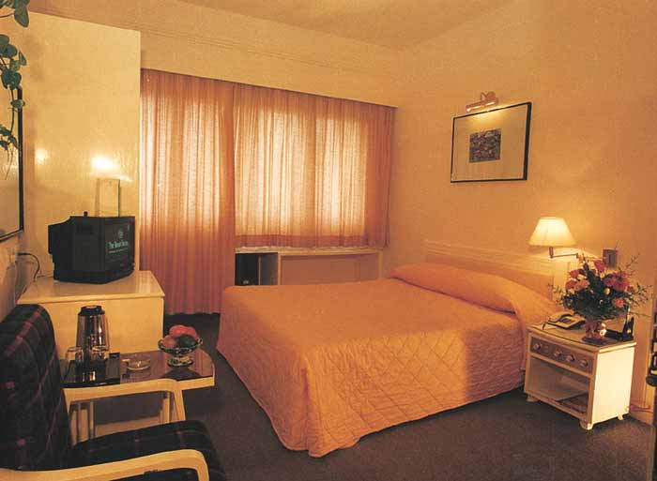
Safety and Security
Despite common misperceptions, Vietnam is one of the safest countries in Asia, and probably in the world.
General Observations
Transportation
Common Sense
Most crime in Vietnam is low-level, opportunistic, and uncommon in comparison with major cities elsewhere
The level of civil unrest is insignificant, crime levels are very low in comparison with most countries, and natural disasters affecting visitors are rare
Overall, focusing on diligence and using common sense is the best practice in providing security
Vietnam's roads range from Western paved standard to cratered and pitted dirt tracks, with the latter in many non-tourist areas
Especially in the cities, traffic can be hectic, dominated by scooters
Participants use a private bus to all CFC-sponsored activities, including weekend excursions
Pedestrian crossings, where they exist, are almost invariably ignored, so visitors need to exercise care when crossing
Do not leave personal belongings unattended - put them somewhere safe or keep them with you
Do not carry a shoulder strap handbag or camera bag – a bag with a handgrip will deter motorbike bag snatchers
Do not carry large amounts of cash or vital documents – nearly all hotels have secure storage
Do not count money while standing at an ATM - put it in a safe place immediately and check it elsewhere
Notes:
Despite common misperceptions, Vietnam is one of the safest countries in Asia, and probably in the world.
The level of civil unrest is insignificant, crime levels are very low in comparison with most countries, and natural disasters affecting visitors are rare
However everyone should use common sense, like not going alone in strange locations and following recommendations from your hosts
Pedestrian crossings, where they exist, are almost invariably ignored, so visitors need to exercise care
In the cities the best technique is to wait for a lull in the traffic, then walk steadily and purposefully across the road
Oncoming bicycles and vehicles will swerve around to avoid a pedestrian
Hopping about trying to avoid the traffic makes an accident more likely
In the cities, and especially in Ho Chi Minh City, petty crime can sometimes be a problem. To avoid difficulties, don’t:
Leave personal belongings unattended - put them somewhere safe or keep them with you
Carry a shoulder strap handbag or camera bag – a bag with a handgrip will deter motorbike bag snatchers
Carry large amounts of cash or vital documents – nearly all hotels have secure storage
Count money while standing at an ATM - put it in a safe place immediately and check it elsewhere

Slide 8
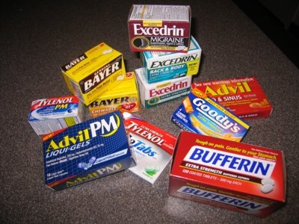
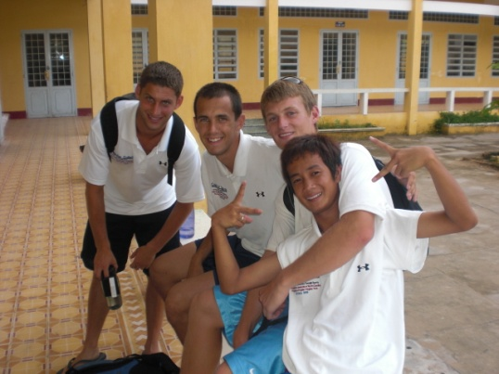
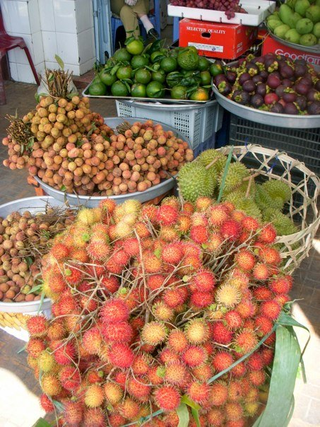
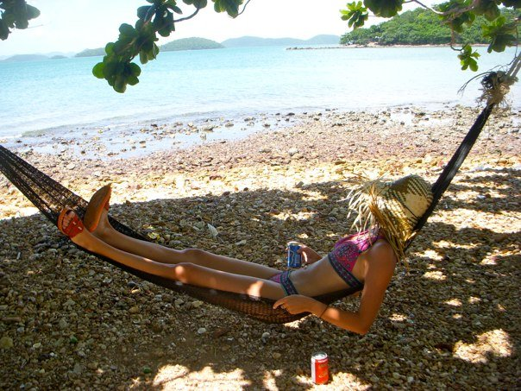
Maintaining Good Health
Few people have health problems in Vietnam. If a medical condition is to arise, we carry a wide range of over the counter medications, and there are health facilities in nearby cities
Your campus health services (remember you must see them by the end of April!) will go into detail regarding the vaccinations and medicines that you need
Below are a few additional tips:
Watch what you eat
Bring hand sanitizer
Wear a Sunscreen
Wash hands often and well
Drink lots of Water!
Wear Sunscreen
Wear a Hat
Notes:
Wear Sunscreen - The major health dangers are the effect of the sun and tropical heat. European/American skin will begin to burn very quickly on a hot day even if the sky is overcast: reputable high UV protection barrier lotions and cream are essential.
Wear a Hat - Sunstroke is also a high risk: a wide brimmed hat that will shade the back of the neck as well as the eyes is better than a baseball cap. Heavy sweating caused by high humidity drains the body’s water supply rapidly.
Drink lots of Water - Drink plenty of water to replenish it and thus avoid unpleasant dehydration – several liters per day is generally recommended.
Drink lots of Bottled Water - Only drink bottled water (even when brushing your teeth). It is not advisable to drink tap water in Vietnam but bottled mineral water is safe and available everywhere. Ice in drinks is generally okay in good standard hotels and restaurants but it is best to avoid it on street stalls or in countryside areas.
Watch what you Eat - Vietnamese food is nearly always cooked from fresh ingredients, so getting an upset stomach is probably less likely in a street side café than in an international restaurant that re-heats pre-prepared food. Still, it’s important to consider the source of your food before eating it.
Bring Over the Counter Medicine - In addition to any necessary prescription medication, it is not a bad idea to bring some over-the-counter medication, such as Ibuprofen, aspirin, and Pepto Bismol. Additionally, it is always wise to have antiseptic hand sanitizer with you at all times.

Slide 9
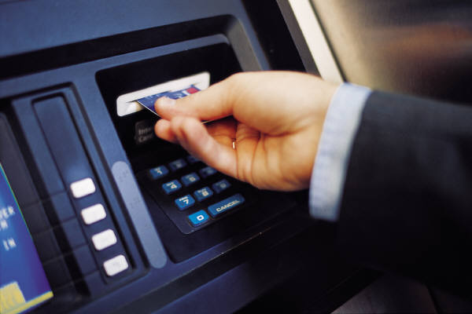
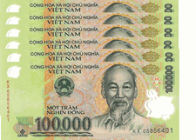
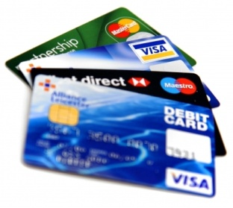
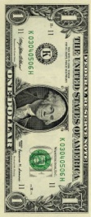
Money and Finances
Traveling with an ATM card, credit card, and a small amount of cash in U.S. dollars as a backup is best. Make sure to bring crisp, new bills. Very worn dollars, or new bills with even small tears or writing on them are usually not accepted)
Obtaining Money
Currency
Tips
What’s Included
Picture of an ATM
Picture of something
ATMs: Convenient, work well, and plentiful in cities
Withdrawals: Max withdraw is 2 million VND, about $100
Fees: Typically around $2.00 in addition to that charged by your bank
Before you leave:
Check how much your bank changes for foreign withdrawals
Alert it you will be travelling to Vietnam, so the card is not frozen
Exchange Rate: $1.00 equals about 20,000 Vietnamese Dong (VND)
Currency Usage: Use Dong for almost everything you buy
US Dollar: Sometimes accepted among major shops and restaurants
Places of Exchange: Dollars can be exchanged for dong at hotels, banks, and licensed exchange shops
Never: Put cash into your suitcase
Protect: Any cash you bring with you should be in a money belt or pouch or zipped pocket
Traveler’s Checks: Not readily accepted
Credit Cards: Visa and MasterCard are only accepted in larger cities, but shouldn’t be relied on as a consistent option for daily activities
Program Expenses: Accommodations, food, and local transportation during the camp and on the weekends are covered
Personal Money: Bringing some cash for personal spending and souvenirs but how much you spend is up to you. It is wise to have some US dollars on you, but otherwise Vietnamese Dong are very accessible at ATMs.
Notes:
Obtaining Money:
ATMs: ATM machines in Vietnam are pretty convenient, work well, and there are a lot of them in the cities
Withdrawals: The most you can withdraw from an ATM at any one time is 2 million VND, which is about $120
Fees: The ATMs usually charge a fee of about $2.00
Before you leave: Check with your bank to see how much they charge for withdrawals in foreign countries AND tell them you will be in Vietnam so they don’t cancel your card when they see strange charges
Currency:
Exchange Rate: $1.00 is approximately equal to 20,833 Vietnamese Dong (VND) –
Yes, you will be a millionaire
Currency Usage: You will use Vietnamese Dong for almost everything you buy
US Dollar: The U.S. dollar, preferably crisp clean bills, is widely accepted among major shops and restaurants
Places of Exchange: Dollars can be exchanged for dong at hotels, banks, and licensed exchange shops (passport must be presented)
Tips:
Never: Put cash into your suitcase
Protect: Any cash you bring with you should be in a money belt or pouch or zipped pocket
Traveler’s Checks: Traveler’s checks are not very convenient, since they are not readily accepted
Credit Cards: Visa and MasterCard are accepted in larger cities like Ho Chi Minh City, but should not be relied upon as a consistent option for daily activities
Most places accepting credit cards for payment charge a 4% fee
What’s Included:
Program Expenses: Every required program expense (accommodations, food, and local transportation during the camp and on the weekends) is included.
Personal Money: You will need to bring money to pay for any souvenirs you want to buy, things you forgot at home, and to pay for any additional things of the excursions on Weekends 2 and 3 of the program
Suggestion: We suggest bringing some cash for personal spending and souvenirs but how much you spend is up to you. It is wise to have some US dollars on you, but otherwise Vietnamese Dong are very accessible at ATMs

Slide 10
Communication Back Home While in Vietnam
Communication with friends and family back home is relatively feasible – it is possible to obtain Vietnamese SIM cards for your phone, and also to access internet on weekends to use email and Skype
Communication Type | Ease of Access | Cost | CFC Recommended
Skype | Excellent – If you have not done so already, you should download Skype (www.skype.com). | Low – This program allows you to place free calls to people with a Skype account and cheap calls to a landline or mobile phone anywhere in the world. | 
Internet Cafes | Good – There are a lot of Internet cafes in the cities. In village, we go to an internet café once midweek. | Very low – Internet cafes often change about 4000 VND per hour. | 
Phone | Ok – Only consistently available in cities. You can use your phone if it works internationally. | High – International phone charges are steep in Vietnam and many hotels, especially up-market ones, add extra fees. | ★
Faxes | Poor – Faxes can be sent from hotels, business centers and post offices. | High – Rates vary, but are typically high. | ★
Note that Vietnam is 11 hours ahead of Eastern Standard Time, so if it is 4:30 PM on the East Coast, it is 3:30 AM the next day in Vietnam.
Notes:
Skype: By far best option is to use internet calling. If you have not done so already, you should download Skype (www.skype.com). This program allows you to place free calls to people with a Skype account and cheap calls to a landline or mobile phone anywhere in the world.
Internet Cates: There are a lot of Internet cafes in the cities which are not very expensive (about 4000 VND per hour). Many restaurants, cafes, and hotels also offer free wireless. Most computers in the Internet cafes use Microsoft Office. However there are not a lot of Mac users in Vietnam. Most computers in the more modern Internet cafes can use jump drives.
Phone: International phone charges are steep in Vietnam and many hotels, especially up-market ones, add extra fees. You can buy local calling cards that you can use to call internationally (for about 70 cents a minute). You can also use your cell phone if it works internationally.
Faxes: Faxes can be sent from hotels, business centers and post offices. Again, rates vary. To rent a mobile phone call 824-2382 in Ho Chi Minh City.
Note that Vietnam is 11 hours ahead of Eastern Standard Time, so if it is 2:30 PM in Durham, NC, it is 1:30 AM the next day in Vietnam.

Slide 11
Next Steps
Keep fundraising
Make and attend appointment at campus health, if you have not done so already
In preparation for our next session, Preparing to Immerse, please read this on the history of Vietnam: http://www.lonelyplanet.com/vietnam/history

