Slide 1
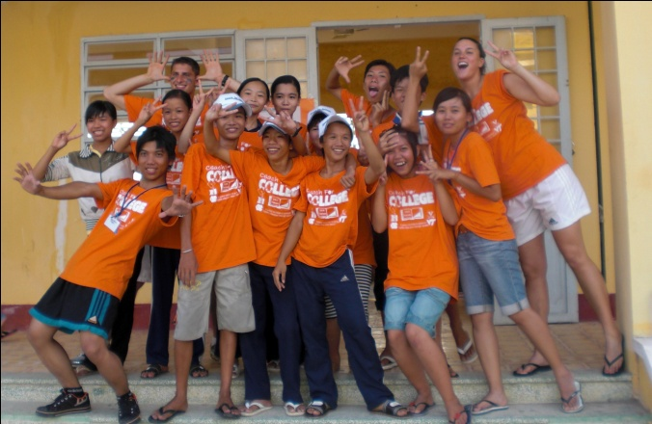
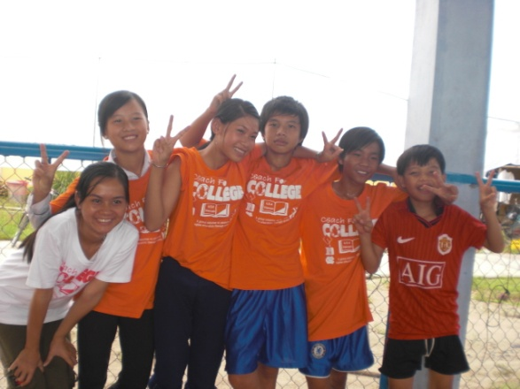
Meeting 6: Wrap Up and Packing

Slide 2
Agenda
Packing list | 3
Camp Itinerary | 9
Behavioral Expectations | 10
Summer Contact Information | 11
Expenses Covered by the Program | 12
Good Reflection Practices | 13
Pre-Departure Checklist | 14
Next Steps | 15

Slide 3
Packing List
You will be gone for at least three weeks. Please see below for recommended packing lists:
General Guidelines
You are responsible for carrying what you pack – you will have to pay any luggage fees that are over the limit of the airlines limitations. Check these, but most often one checked bag is allowed, weighing a maximum of 50 pounds.
Electrical current in Vietnam is 220V. The outlets are the two round pronged European type, though often outlets take both round pronged and the flat US plugs it could be a good idea to bring an adaptor so that your plugs will fit the round holed sockets. Check the small print on your electrical plugs to see if they will work up to 220V. If not, you will need to bring a transformer (rather than a plug that simply adapts to the shape of the outlets).
Besides exercise clothing to wear during the camps, pack one or two outfits for specific situations (e.g. swimming, rain, and casual clothes for the weekend trips). Bring university shirts to wear 2 days each week.
Bring snacks (peanut butter, granola bars, PowerBars, protein powder, cereal, etc. – these foods will not be readily available in Vietnam, and protein content in the meals is less than what many student-athletes may be used to). We recommend bringing powdered drinks (such as Gatorade). Dehydration has been a nagging occurrence in past years. Drinking plenty of water helps, but being able to replace electrolytes, will keep you healthiest. Probiotics also help to restore order for a gastrointestinal system that has been disturbed, and are recommended.
DO NOT bring items that you want to keep white and / or that need special laundering
Toiletries and personal hygiene items are readily available, however a few items cannot be as easily purchased (cotton balls, dental floss, deodorant and tampons) – we recommend that you bring these items with you from the US.
Clothing and shoes are available for purchase everywhere, but the sizes tend to be smaller than in the US
Other items you may want to bring: hand sanitizer, disinfectant wipes, INSECT REPELLANT, SUNSCREEN, lotion, personal school supplies, a small flashlight and a travel alarm
Hair dryers, curling irons and hair straighteners are not recommended (if you do bring them, you almost certainly should also purchase a transformer for them).
It is strongly recommended that you buy a money / document pouch that can be worn or hung underneath your clothes, particularly if traveling after camp.
Keep in mind that these are suggestions

Slide 4
Recommended Suitcase and Electronic Packing List
Below you will find a list of recommendations regarding suitcases and electronics
Suitcases
Remember – you will be in charge of carrying your luggage during the entire trip, so keep it to a minimum, in terms of weight and size
 | One large suitcase, backpack or duffle bag with wheels. Don’t over-pack!
 | One smaller carry-on day-use backpack
 | Label all luggage with your full name and address (including country)
Electronics
All of this is optional – just please keep in mind the voltage differences between Vietnam and the United States
 | Camera (with USB cords and memory cards)
 | Ipod or CD player and headphones (especially for Skype). A bluetooth speaker may be very fun to use with the kids
 | Laptop (but ensure you have anti-virus software)
 | If you have a computer that plugs into all 3 holes, you will want an adaptor that allows you to plug it in with just two flat prongs, or an adaptor from flat prongs to 2 round prongs, allowing you to plug in your devices everywhere.
 | Travel alarm clock
 | Headlamp for reading (with an extra battery)
 | Flashlight or headlamp
 | Extra batteries (batteries are readily available in Vietnam, but often do not last long, and are not strong enough to run cameras
Keep in mind that these are suggestions

Slide 5
Recommended Medicine and Toiletries Packing List
Below you will find a list of recommendations regarding medicine and toiletries
Medicine
There are pharmacies in the cities, however we recommend that you bring medicine you anticipate needing, when possible. CFC staff will have a store of basic first aid supplies and basic over the counter medicines, so there is no need to bring a whole pharmacy, however it would not hurt to bring a few basic items, particularly if you plan to travel after the camp.
 | Any prescription medications in their original packaging (enough for the entire trip)
 | Photocopies of all prescriptions for medicines you bring
 | Vitamins
 | An antibiotic for gastrointestinal illnesses, if recommended by your doctor.
 | Advil / Aspirin
 | Neosporin
 | Any other over-the-counter medicines you think you might need – cold medicines, anti-diarrhea medicines
Toiletries
 | Mosquito Repellent (with Deet) |  | A roll of toilet paper (many bathrooms do not have it) |  | Face and body wash cloths |  | Sunscreen of SPF 25 or higher
 | Anti-itch cream |  | Shampoo, Conditioner |  | Face wash |  | Disinfectant wipes
 | Band-aids |  | Toothbrush, Toothpaste |  | Q-tips |  | Hand sanitizer
 | Face and body |  | Hair brush |  | Deodorant |  | Contact solution
 | Soap |  | Razor with extra blades |  | Tampons |  | Other
Keep in mind that these are suggestions

Slide 6
Recommended Clothing Packing List
Below you will find a list of recommendations regarding clothing
Clothing
You will be given 2 CFC t-shirts to wear to camp (MWF); wear your college shirts TTh. Laundry can be done hand in the evening or at lunch.
 | Exercise clothing. You won’t need a lot of this extra clothing because you will get CFC T-shirts to wear during the camp - 2 total (one for MW, and one for F). TTh coaches wear shirts with their university logo. Bring 2 or 3.
 | In general, try to bring light and airy clothing as well as clothing that dries quickly and does not wrinkle.
 | Bring some casual outfits for the weekends: airy, breathable long sleeve pants and shirts as well as shorts and short sleeve shirts Light but long sleeved keeps off both sun and mosquitoes. Avoid bringing jeans. Guys should bring T-shirts; girls should bring lightweight T-shirts or thick strapped tank-tops.
 | Don’t bring anything you are sentimentally attached to. A lot of your stuff you wear during the week will get sweaty and dirty and maybe even lost. Stick to inexpensive and basic garments. Vietnamese tend to dress less casually than Americans, however, so making an effort to look neat will be appreciated.
 | Undergarments (underwear, sports bras; the more the better so you won’t have to worry about laundry)
 | A few pairs of socks
 | Swimsuit (Vietnamese women tend to wear shorts and a T-Shirt or occasionally a one piece bathing suit, though you don’t have to do this)
 | Pajamas
 | One long sleeve shirt or very light, breathable jacket
 | A nice outfit or two to wear in the city, such as a nice sundress for girls and nice pants and shirt for guys
 | One pair of athletic shoes
 | Sandals/flip flops
 | One pair of nice shoes (optional)
 | Raincoat/rain jacket (optional)
Laundry
Laundry can usually be done by local staff at the housing facility, however it will cost you extra and may not be up to your standards so be prepared to sometimes wash your clothes yourself (by hand – detergent can be readily purchased on site)
You can do laundry at the hotel on weekends, however it may be expensive
Keep in mind that these are suggestions

Slide 7
Recommended Miscellaneous Items Packing List
Below you will find a list of recommendations regarding miscellaneous items
Miscellaneous Items
Keep in mind that if you forget anything that you need, you will be able to purchase most necessities in the major cities
 | ATM and Credit Card (call your bank before you are leaving to inform them of where you will be using it) |  | *Photocopies of all important documents (passport, visa, immunization records, credit cards, flight info)
 | Some cash in US Dollars (good condition, new bills) |  | Money belt or purse to wear inside your clothes
 | Travel games, cards, etc. |  | Zip-lock bags
 | Travel books |  | Journal
 | Small pillow and top sheet for bed (the pillows provided can be hard; the bedding consists of a fitted sheet and fleece blanket) |  | Sleeping bag (optional – it will be hot so this is probably not needed, but you could bring it if you want to put it on top of your bed for extra padding)
 | Snack food and water mixes (power bars, granola bars, peanut butter, Gatorade powder, etc.) |  | Small gifts to bring to the VN coaches (especially those with your school emblems). Photos of yourself.
 | Umbrella (optional) |  | Duffel bag or backpack for weekend trips
 | Water bottle / Nalgene that can be reused |  | Passport and one other government issued photo ID
 | Towel |  | Video clips of you or your team playing your sport
Keep in mind that these are suggestions
*PACK PHOTOCOPIES separately from the originals. Pack all valuables and medicines in your carry on!

Slide 8
Recommended Items to NOT BRING
You should NOT BRING the following items:
Items to NOT BRING
Do not bring any of the following items with you to Vietnam
 | Alcohol or drugs
 | In carry-on luggage, no knives, pocket knives, tweezers, scissors or nail clippers
 | Clothes or other items resembling military paraphernalia – no camouflage or army issue or clothing
 | GPS
 | PDAs or night vision technology
 | Items on Restricted Items List (https://www.united.com/web/en-US/content/travel/baggage/dangerous.aspx)
 | Anything that you would be upset if you lost or it got broken
Keep in mind that these are suggestions

Slide 9
Camp Itinerary
Time Table
 | Camp Calendar
American Coaches Leave United States | Wednesday
American Coaches Arrive in Vietnam | Thursday
US and VN Coaches Arrive at Camp site and Move in | Saturday
Coaches Orientation, Registration and Pre-camp Surveys | Sunday
Week 1 Classes | Mon.-Th.
Week 1 Competition | Friday
Group weekend trip | Sat.-Sun.
Week 2 Classes | Mon.-Th.
Week 2 Competition | Friday
Group weekend trip | Sat.-Sun.
Week 3 Classes | Mon.-Th.
Final Competition | Fri-.Sat.
Awards Ceremony | Sunday
Good bye to kids and then to Vietnamese coaches | Sunday
Departure | Sunday

Slide 10
Behavioral Expectations
The full details of the Behavioral Expectations can be found in the Participation Agreement form that you have already filled out and submitted, however please see below for the most important tenets of this document
During the Program
Be in compliance with the honor code of your university and community standards
Perform all duties, work responsibilities and obligations assigned by the program director
Respect the local people, traditions and customs of Vietnam
Strive to be a good ambassador for your athletic team, your university, the Coach for College program, and your country, to the best of your ability
Be responsible for the payment of any changes to airline flights, personal travel after the program and obtainment of visas for personal travel
Abide by all applicable laws in Vietnam with respect to alcohol and controlled substances
Do NOT possess, consume, furnish, or distribute any alcoholic beverages during the weekdays (Monday-Thursday) of the camp or any time when you will be in contact with students. If you choose to consume alcohol on weekends, do so in moderation. Intoxication is not acceptable (or safe in a foreign environment).

Slide 11
Summer Contact Information
You will have access to internet while you are at camp. The best way for your family and friends to get a hold of you is via email or Skype
If there are any concerns or issues, your parents can call Seth Napier, who will be on site in Vietnam throughout the camps. Please ask them to bear in mind the 11 hour time zone difference (from the East Coast), and to only call during the night in the case of a true emergency. Ai Tam, CFC’s Vietnamese counterpart to Seth, will also be on call, and can be called as a backup option. If dialing from the US, the numbers below should be preceded by 011 (i.e. 011 84 169…).
If a US number is required, parents can call Parker Goyer, at 1-919-218-0635.
Seth Napier Contact Information
Nguyen’s Contact Information
Phone Number: +84 (0) TBD in May
Email Address: seth.napier@coachforcollege.org
Skype Name: sethnapier
Phone Number: +84 (0) 989-283719
Email Address: nguyen.tran@coachforcollege.org

Slide 12
Expenses Covered by the Program
Expenses covered by the program will include water on-site meals at the guest house, shared bedroom at the guest house, water at the school, and snacks at the school, transportation from the airport and to the school each day.
You will receive a Curriculum Binder (containing lesson plans for Academic and Life Skills Classes) and Program Handbook.
You will receive 2 CFC shirts (one will be worn Mon and Wed, one will be worn on Friday during Competition Day). On Tuesday and Thursday, both US and VN coaches wear apparel representing their university.
At the end of the camp (last Sun. of camp) you will return to HCMC with the other American college students. The program does not pay for dinner or accommodation on the last Sunday of the camp in HCMC.
Items Not Included
Item | Notes
Extra Food/Drink on All Weekend Trip Lunches, Weekends 1-3 | The program provides an amount to cover a basic meal, but at some weekend meals, coaches are free to choose where they eat, and splurge on something more expensive.
Extra Snacks throughout Camp | There are many inexpensive local treats that coaches enjoy trying.
Dinner and Accommodation last Sun. of camp in HCMC. | Local staff can help you arrange, but the program does not cover it.
Health Care Expenses | Any health care expenses you incur during the camp (medicines, hospital, etc) must be paid by you at the time they occur. The health insurance policy is in your name. You can be reimbursed after the program by filing a claim with the insurance company.
Laundry | Can do it yourself for free (by hand in the bathroom at the guest house) or can pay for the guest house staff to do it (8000 VND/piece). Detergent packets readily available. No need to bring it.
Some weekend entry fees and activities | Depending on the location and the preferences of the group, there may be a few activities that the coaches pay for (entrance to some historic sites, group karaoke, massage, etc.)

Slide 13
Good Reflection Practices / How to Get the Most Out of the Program
Reflection is the key to getting meaning from your service experience. It is a process by which service-learners think critically about their experiences. Reflection can happen through writing, speaking, listening, and reading about the service experiences.
Importance of Reflection
Ways you can practice reflection:
Keep a journal or blog
Take pictures
Talk about your experiences, feelings, reactions with your American and Vietnamese peers to get different perspectives (with an approach of being open and not critical)
Think about not only what you are learning about Vietnam, but also what you are discovering about yourself and US cultural expectations.
Outcomes from Reflection
Effective Problem Solving
By examining experiences, you will discover ways to handle real life problems more effectively, both in your service projects and in other areas of your lives
Life-Long Learning Skills
By learning how to reflect on positive and difficult experiences, you will develop a greater ability to learn from a challenging experience
Increased Sense of Personal Power
Through examination, you can clarify your goals and priorities and develop a variety of ways to accomplish them
Higher Level Thinking
Reflecting on service encourages you to deal with the root causes of complex issues. You will learn to look for the big picture and recognize what is truly important in your lives
Academic Skills
Reflection can act as a vehicle to link a broad range of academic skills to the your direct experience
Celebration
Thinking about the high points and the benefits enables you to feel a sense of renewal and accomplishment
Improved Service
As you examine the effects of your behavior, you discover ways to improve the quality and quantity of your service
Improved Program
Both directors and coaches receive important feedback on strengths and weaknesses of the program
Notes:
Why is reflection important? Community service, in itself, can be meaningful, pointless, or harmful. Learning happens through a mix of theory and practice, thought and action, observation and interaction. It allows students to learn from themselves.

Slide 14
Pre-Departure Checklist
Call your bank before you leave to let them know that you will be in Vietnam and may use your ATM and credit card there.
Print your flight itinerary and make copies of all important documents to bring with you
Bring 2-3 copies of your visa acceptance letter (the airlines may request to keep a copy when you board the various legs of your flight).
Bring 2 passport photos (more if you plan to travel to other countries after the program which require a visa)
Bring cash in US$ to cover the visa fee, when you go through customs on arrival (CFC will reimburse this to you in Vietnamese currency after you arrive)
Print up email from CFC with detailed instructions on what to do in any contingency while flying, how to go through customs, and where to meet CFC staff upon arrival. This email will be sent to you a few days before you leave the US.
Finalize any post-CFC travel plans (and bring copies of those itineraries too!)
Purchase supplemental insurance for travel after CFC (if interested)
Bring US Dollars when you travel, including some in small denominations. Make sure they are bills in excellent condition (not worn, with no tears or writing on them. The newer the better).
Set up an international service for your cell phone (if interested in this option). Create a login for yourself and your parents on Skype.
Familiarize yourself with your lesson plans and do additional research as necessary

Slide 15
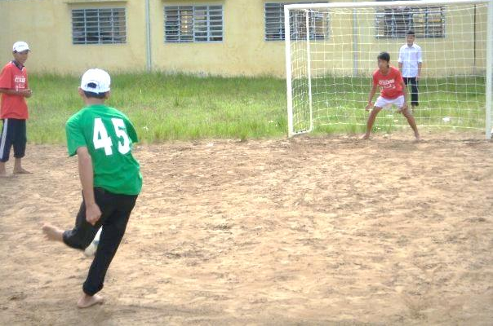
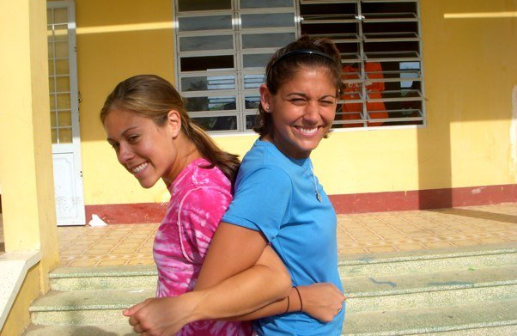
Next Steps
Pack!
Pick up necessary prescriptions and medicines
Double check that you have your passport, multiple copies of your visa support letter, as well as itinerary and contact information for Seth Napier in Vietnam, should you have any travel issues.

