Slide 1
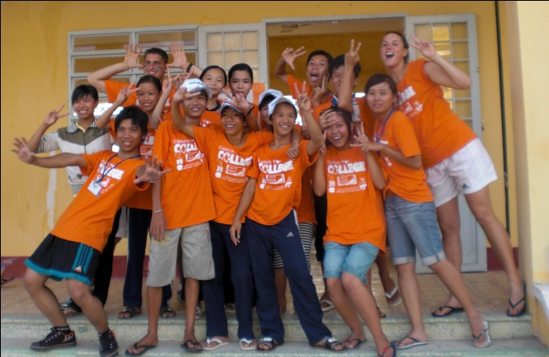
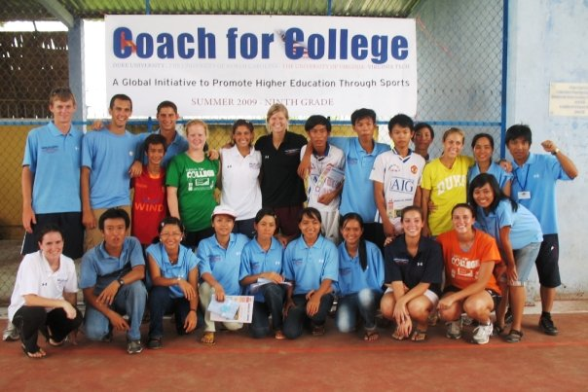
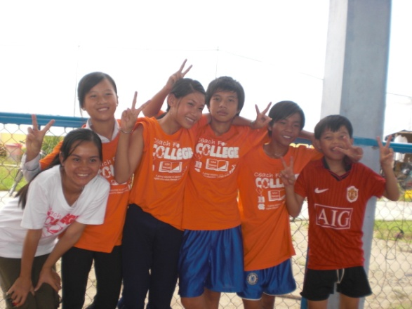
Session 3: Preparing to Immerse

Slide 2
Agenda
Why Vietnam? Rationale for Program Location | 3
Living Conditions for People in Rural Vietnam | 4
Life for Vietnamese Middle School Youth | 5
Vietnamese Beliefs and Practices | 6
Vietnamese Practical Do’s and Don’ts | 7
Best Practices for Volunteering Cross-Culturally | 8

Slide 3
Why Vietnam? Rationale for Program Location
97%
Desire for Higher Education
92%
In Vietnam individuals from less privileged backgrounds are often not able to pursue higher education
87%
Tracking Drop Out Rates
5%
% to start level
% to complete level
% to drop out
Desire for Organized Sport
In many parts of Vietnam, particularly in rural areas, people cannot afford to buy sports equipment.
There are no recreational sports leagues during the year, involving competitions between different schools
11%
57%
4%
CFC Fits These Needs
Coach for College fills these voids simultaneously by providing:
Infrastructure for sports
Coaches to teach the students academic subjects and life skills, both motivating them and giving them a boost in the upcoming school year
Teaching life skills they can use in school and the rest of their life
Relating sports to key educational aspects
3%
54%
Primary School
Secondary School
High School
University
Notes:
Statistics for this commune
85% of those who complete primary school continue on to middle school and 70% of those who complete middle school continue on to high school. Of those who make it to high school, only 2.8% continue on to college
Desire for Higher Education
In Vietnam individuals from less privileged backgrounds are often not able to pursue higher education as frequently as more well-to-do students are
Only 2% of the Vietnamese population had 13 years or more of education
Vietnam's National Commission on Education has called for the Vietnamese government to seek American aid to improve its higher education system
The Ministry of Education and Training submitted a plan in 2005 to renovate education in the country
Desire for Organized Sport
Sports in Vietnam are becoming increasingly popular at a grassroots level
In many parts of Vietnam, particularly in rural areas, people cannot afford to buy sports equipment.
As a result, the only people who participate extensively in sport are those who can afford to pay the rental fees required to use sports facilities
There are no recreational sports leagues during the year, involving competitions between different schools
There also are no sports leagues at the community or university level in Vietnam
How CFC Fits These Needs
Coach for College fills these voids simultaneously by providing infrastructure for sports, coaches to teach the students, structured competitions, and relating sports to key educational aspects and the pursuit of higher education through the values learned in sports

Slide 4
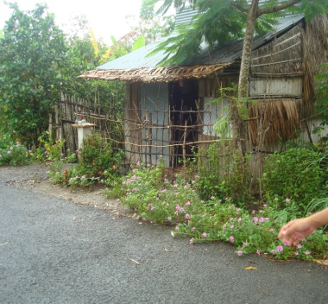
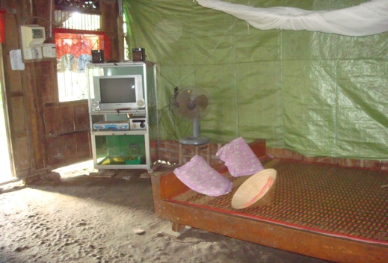
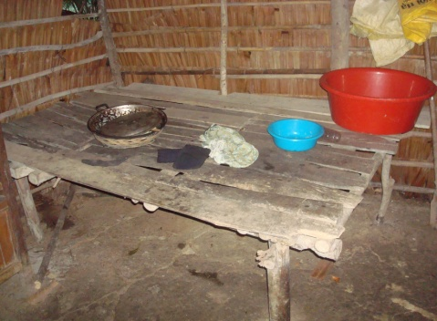
Living Conditions for People in Rural Vietnam
18% of the people in this area live below the poverty line. 90% of the population lives on farming, handicraft making and small business
During your time at the camps, you may have the opportunity to visit the homes of your students
Often the homes are self-constructed and use a variety of natural materials
Many times, the floor is just packed earth
There is usually one bedroom, in which the parents have a bed (no mattress – just a flat bed frame with a mat) and the children all share one bed or mats on the floor
The children mainly go to the bathroom outside or in outhouses
Nearly all households engage in some form of agriculture, whether it be growing rice, raising other crops, raising animals or fishing in the backyard pond
Notes:
During your time at the camps, you will have the opportunity to visit the homes of your students
Most of the homes are self-constructed and use a variety of natural materials
Many times, the floor is just matted dirt
There is usually one bedroom, in which the parents have a bed (no mattress – just a flat bed frame) and the children all share one bed
The children mainly go to the bathroom outside
Nearly all households engage in some form of agriculture, whether it be growing rice, raising other groups, raising animals or fishing in the backyard pond

Slide 5
Life for Vietnamese Middle School Youth
Description
The participants in the camp are rising 6th, 7th, 8th, and 9th graders from communes in the district around each camp
Proximity to the Middle School
Approximately 2/3 of all camp participants live within 5km of the school and either ride their bike or walk to participate (travel time can take up to 40 minutes each way)
Family
On average, there are 5 members in their families (including their parents)
70% of their parents are rice farmers
Frequency of Travel
10% travel out of their community often
40% rarely leave their community (if they do, it is typically Can Tho or Long Xuyen, 25-45 miles away)
10% have never left their community
Roughly half of the students have interacted with Americans before, due to CFC camps in past summers
Lifestyle – School Year
Lifestyle – Summer
Most help with chores around the house and farming
During the school year, about 75% go to school in the morning, but only 50% go in the afternoon (usually to help their families in the rice fields or in doing chores around the house)
Most common evening activities are doing homework (20%) and watching TV (10%)
Less than 10% reported playing sports as a typical activity during the school year
Activity | %
Help parents with housework / chores | 44%
Go out and play with friends / hang out | 18%
Watch TV | 15%
Review lessons / self study | 13%
Help parent or relative with their job | 10%
Play sports / do exercise | 10%

Slide 6
Vietnamese Beliefs and Practices
TIPS
COMMON BELIEFS AND PRACTICES
1
Don’t tell them how to run their country
2
Dress Respectfully
Don’t expect Western-style politeness
3
4
Don’t get cross
5
Think before you complain
6
Don’t be rude
http://www.youtube.com/watch?v=jlmM9Z0eU6s
7
Laugh and smile as much as possible!

Slide 7
Vietnamese Practical Do’s and Don’ts
Do’s
Don’ts
ALWAYS drink plenty of bottled water. Drink a minimum of 2 liters per day.
Ensure you have a hotel business card from the reception desk before venturing out from your hotel. This will make your return to the hotel in a taxi or motorbike much easier.
Carry a small roll of toilet paper in your daypack. You never know when you will need it. A lot of bathrooms in Vietnam do not have toilet paper.
Vietnamese have conservative dress codes. Always dress appropriately, not only for the prevailing climatic conditions but also not to cause offense to the local people.
Leave excess cash, airline tickets, passports and valuables with the hotel’s safety deposit facility.
Remove your shoes at the front door.
Always ask the person’s permission first when taking a photograph of someone. If they indicate that they do not want you to, then abide by their wishes. DO NOT push the issue or offer money.
Never wear shorts, dresses or skirts, or tops with low-neck lines and bare shoulders to Temples and Pagodas. This is considered extremely rude and offensive.
Never sleep or sit with the soles of your feet pointing towards the family altar in someone’s house.
Never venture out from where you are staying with more cash than you really need for that day. It is NOT something to be paranoid about, simply do not make yourself a target for pickpockets or drive-by bag snatchers in the big cities.
Never lose your temper in public or when bargaining for a purchase. This is considered a serious loss of face for both parties. Always maintain a cool and happy demeanor and you will be reciprocated with the same.
Never try and take photographs of military installations or anything to do with the military or police. This can be seen as a breach of national security.

Slide 8
Best Practices for Volunteering Cross-Culturally: Perceptions
Americans don’t show very much respect for their elders
Americans always have to say what they are thinking
How does this make you feel?
Americans insist on treating everyone the same
Americans always think things are going to get better
Americans are always in such a hurry to get things done
Americans always want to change things
Are these perceptions of Americans appropriate? Fair?
Americans are so impatient

Slide 9
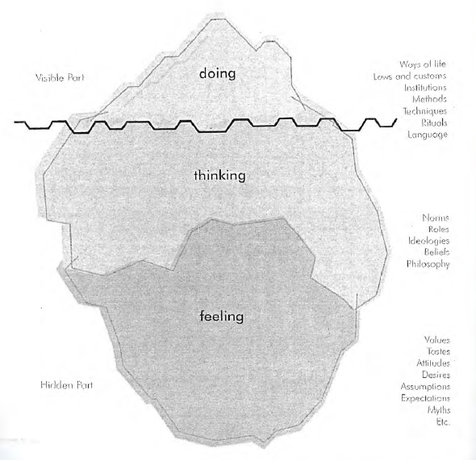
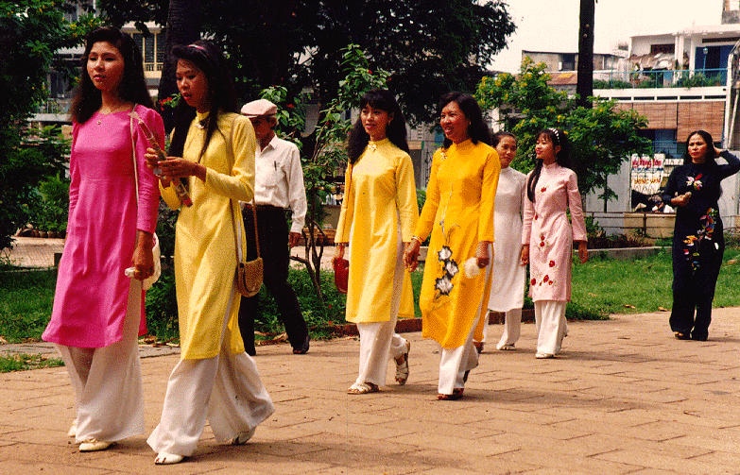
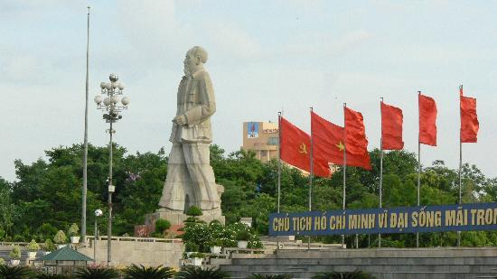
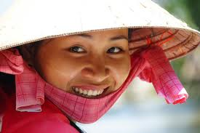
Best Practices for Volunteering Cross-Culturally: Iceberg
Above water line (DOING): Aspects of culture that are explicit, visible, and taught.
Visible
At the water line (THINKING): The area where official explanations and theology becomes faith.
Below the water line (FEELING): The habits, assumptions, understandings, values, and judgments.
Hidden
Notes:
When seen on the water, only approximately 10% of the iceberg can be seen—most of it is below the surface. This model is useful in helping us understand behaviors of members of other cultures.
Above water line (DOING):
Aspects of culture that are explicit, visible, taught. This includes written explanations, as well as those thousands of skills and information conveyed through formal lessons. Also above water are the tangible aspects: from the "cultural markers" tourists seek out to the conformity in how people dress
At the water line (THINKING):
The transition zone is where the cultural observer has to be more alert: "now you see it now you don't", the area where implicit understandings become talked about, explained--mystical experiences are codified into a creed; the area where official explanations and teachings become irrational, contradictory, inexplicable--where theology becomes faith.
Below the water line (FEELING):
"Hidden" culture: the habits, assumptions, understandings, values, judgments ... that we know but do not or cannot articulate. Usually these aspects are not taught directly. These sorts of daily rules are learned by osmosis -- you may know what tastes "right" or when you're treated "right", but because these judgments are under-the-waterline, it usually doesn't occur to you to question or explain those feelings

Slide 10
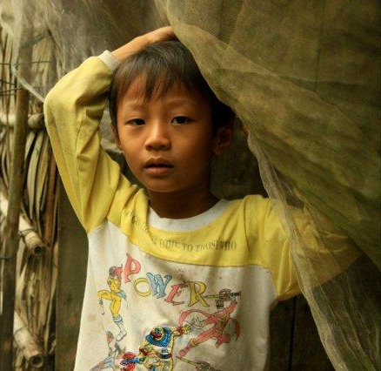
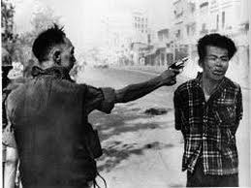
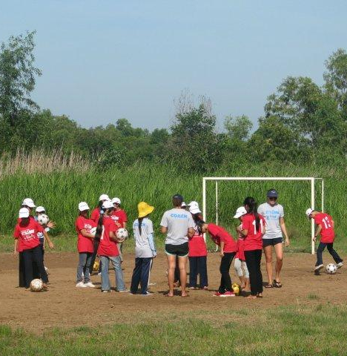
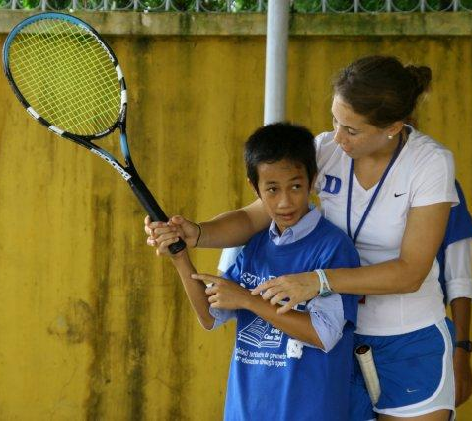
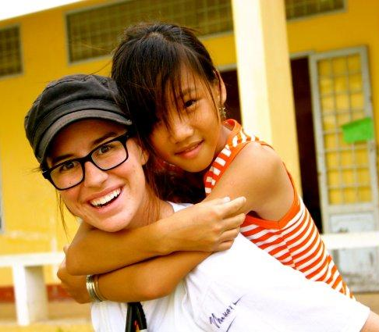
Best Practices for Volunteering Cross-Culturally: Tips
Money
Read notes at bottom of the page
Picture of Coach giving a gift to participants
Resources
Understand the Culture/History
Be Culturally Sensitive
Religion
Communicate
Attitude
Notes:
Money: A common assumption is that all Americans are rich, and thus, the Vietnamese may expect money or gifts – while it is okay to bring some gifts, do not be excessive (and have them be useful – such as school supplies, or personal). A good idea for gifts for the kids is to bring a stack of yearbook/passport photos to leave with kids and VN coaches. Making an album with pictures (or postcards) of your family, home, campus, you competing for your team, your city, etc are good ways to connect and show who you are (Vietnamese usually very much enjoy getting a glimpse of your background and life in the US).
Resources: Be wary of not wasting resources (don’t take really long showers, blatantly leave food on your plate, throw away clothing that is dirty but still wearable, etc.)
Understand the Culture: Be familiar with the political, social and cultural context of Vietnam by reading and understanding all of the preparation materials and reading up on your own about the country and culture
Religion: Being yourself and open about your beliefs is fine, but do not spread messages about religion – this is not a mission trip.
Communicate: Do all that you can to try to relate to the Vietnamese (games, smiles, high fives, body language, sign language, pictures) – show that you are willing to try to communicate with them – don’t get frustrated if you are having a hard time – just keep trying and always maintain a positive attitude. Learning a few words and phrases in Vietnamese gets a very good reception.
Attitude:
Americans generally show a lot of sympathy, but not empathy – be careful so as not to position yourself as superior to the Vietnamese (or consider them inferior).
Manage perception of Vietnamese (generally not a problem with the children, but could be with some of the parents – especially those who lived through the Vietnam War era)
Do not be condescending or think you are better than the Vietnamese partners we will be working and living with.
Be Culturally Sensitive:
Manage perception of feeling as an intrusion and forcing your values and culture on the students
E.g. A great way to illustrate cultural sensitivity is in modest dress. Despite the hot weather, women usually wear light weight pants or longer shorts. You’ll rarely see your Vietnamese coach counter-parts in the short-shorts often worn by American athletes today (though it is becoming more common). There have been a few cases in past camps of American coaches removing their shirts to reveal just a sport bra. While it’s certainly important to balance personal comfort, showing cultural sensitivity by taking steps to conform to, or at least acknowledge, the Vietnamese expectations on dress is an easy way to show respect for their lifestyle. In place of short-shorts, female coaches should consider bringing longer “basketball” shorts or capri-pants, as well as something to cover bathing suit bottoms while on weekend trips. (Protecting from the intense sun and potentially disease-carrying mosquitoes is an important reason to cover up as well).

Slide 11
Next Steps
Keep fundraising, if you have not met your goal. Contact us if you are feeling anxious about your progress and would like some ideas.
Appointment for vaccinations and prescriptions should already have been held.

