Slide 1
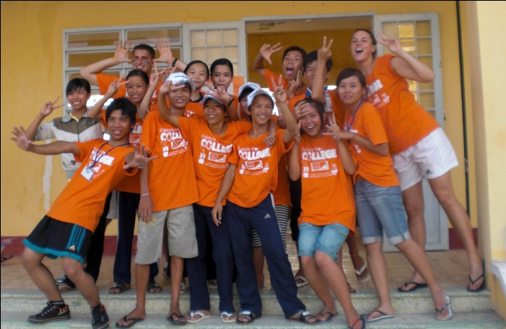
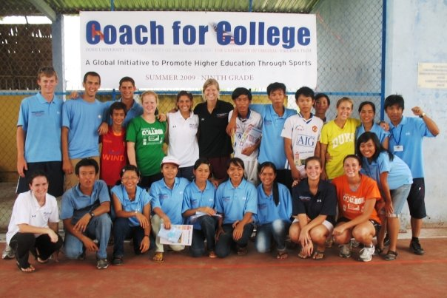
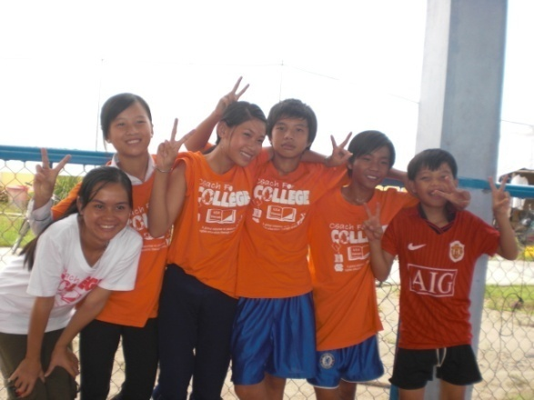
Session 1: Coach for College Kickoff

Slide 2
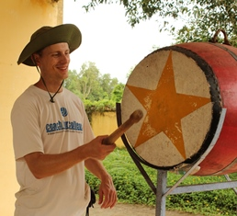
Introduction
Seth Napier
Name: Seth Napier
School: Duke
Major / Graduation: Biology, International Studies
Email Address: seth.napier@coachforcollege.org
Phone Number: 919-399-5095
Fun Fact: I grew up in Italy, about an hour from Venice
My Experience
Have been leading the teams in Vietnam since 2012
I have a master’s in International Development
Prior to joining Coach for College, I worked in Indonesia and Cambodia with local development projects.
I studied abroad in West Africa and led a summer-long student team in Uganda, prior to CFC.
One of my favorite parts of CFC is seeing the growth and transformation in the coaches. The difference from the person who steps off the plane to the person confidently and tearfully heading home is amazing.
The person I am today has been deeply shaped by the privilege of learning from other cultures, and even more so by the discovery that I can make a difference in the lives of others, and how meaningful that is. I enjoy helping coaches begin to experience both these exciting aspects through their service in the camps.

Slide 3
Jessica Wacker, UNC Fencing
If you were to ask a UNC athlete what their favorite college sport moment was, you would probably hear about a national championship game. You might hear about an unbelievable comeback or even about grueling morning practices that were only survived because they could complain to their teammates. If you asked me what my favorite college sports moment was, you would be shocked to hear that it included celebrating with someone from Duke. Yes, Duke… [In Coach for College] I was assigned to the Blue Team and co-coached with Reka, a Duke tennis player. We instantly became friends and discovered we had a lot more in common than we thought. She and I had fun trying to explain sports idioms and expressions like seeing the glass as half full. I was also assigned to teach physics with Ben, a Duke runner…
We began with little steps. Team building activities like tying the team members together with a jump rope and having them walk across the basketball court as a group. We were trying to help the children understand teamwork and communication but these activities were confusing to the children at first. Even after explaining that they had to work together as a team to be successful, I was still met with blank stares. I couldn’t help but laugh when my team decided not to work together but instead to each run in their own direction and ultimately fall. It was only after they failed that they realized how important it was to work together… At the end of the competition day there was an awards presentation. Each team was called up with their coaches to receive certificates for participating. When it came time to announce the overall winner I was thrilled to hear my Blue Team had won first place! Reka and I were speechless. The team rushed to the front to get their prizes. That was my favorite sports memory from my time at UNC. Sure, I had my share of comebacks and victories, upsets and titles but none of them brought the same joy as that moment in Vietnam.
For more stories from past participants go to: http://www.blurb.com/books/2997315. Make sure to click on full screen mode.

Slide 4
Luke Stowers, Florida State Track & Field
I’ve been asked time and time again to identify my favorite moment from my time with Coach for College. I could go with celebrating July 4th with the Vietnamese and singing karaoke (a favorite pastime in Vietnam); I could write about time spent on an island with the other coaches, laying out on hammocks and wading through the water; or I could spend time on learning to bargain and touring through Can Tho, seeing a Buddhist Temple and the Mekong River. The greatest moment however came on a regular day of classes. We began to teach our afternoon lesson of Life Skills (typically a class involving finances, teamwork, or leadership) when a monsoon came and subsequently began to cover the entire world (or so it seemed at the time) with sheets upon sheets of rain. Rather than stay in classes, we decided to go outside and play sports. So we threw off our shoes and began sprinting through puddles and rain, having the time of our lives.
In that hour or two of rain, the students and coaches came together as we hadn’t believed possible. Suddenly, the language and cultural barriers meant nothing; we looked to each other and knew exactly what the others were thinking. My yellow team and I decided to take on all comers in basketball, playing as a true team for the first time, and so it came as no surprise when they took first place as the overall best team a few weeks later. Maybe that day we didn’t actually learn the academics that we were supposed to, but we learned something far more important: teamwork, sportsmanship, encouragement, how to communicate, to have a great attitude when everything seems bad around you, and to sometimes relax and live! That one time may have been the most important in inspiring them to go to university just because of the bond that they developed with us college students. Through rain and sports, Vietnamese and Americans became truly united despite differences in income, government, language, upbringing and education, and we finally understood what the entire program was for.
For more stories from past participants go to: http://www.blurb.com/books/2997315. Make sure to click on full screen mode.

Slide 5
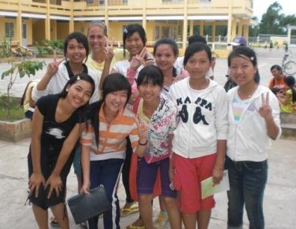
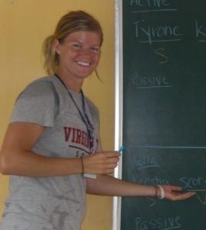
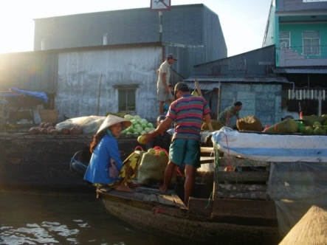
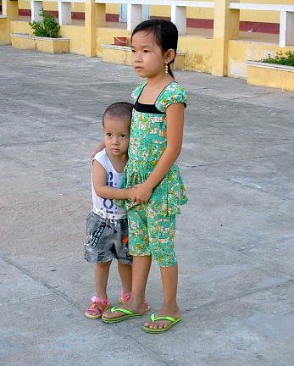
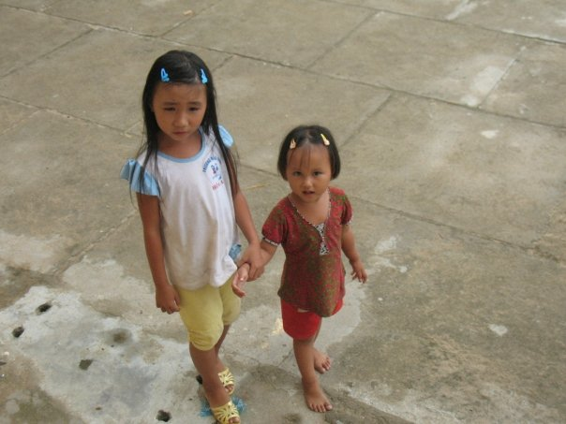
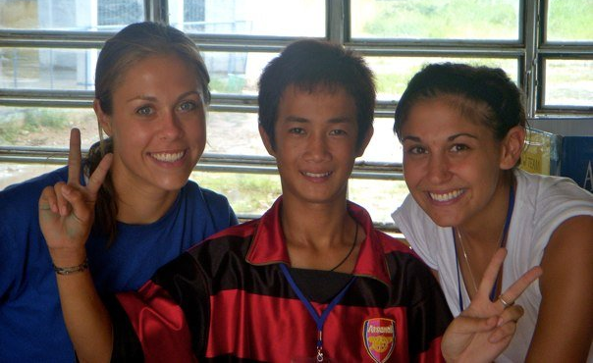
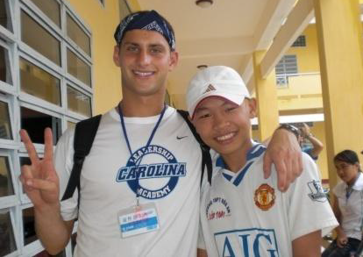
Program Overview
Use sports as a catalyst for change.
Support lower secondary students in rural parts of developing countries.
Foster the development of the college students who participate in the program.
Notes:
Coach for College is a travel and service program that connects ACC student-athletes with middle school students in rural Vietnam promoting the value of higher education through sports
Foster the development of the college students who participate in the program by: Less copy write infringing
Leading to their transformation into capable leaders
Equipping them to bring about positive global change
Support lower secondary students in rural parts of developing countries by:
Increasing their motivation and ability to take advantage of higher educational opportunities
Utilizing the excitement and life skills provided by participation in sports

Slide 6
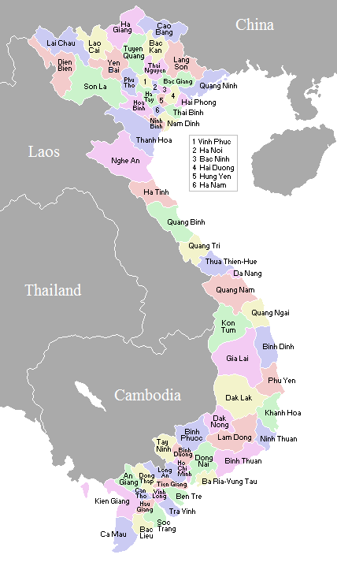
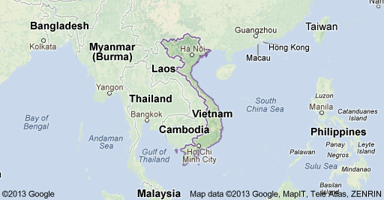
Site of the Program
The CFC program has operated in Vietnam since 2008.
Coach for College runs camps at 5 schools in Hậu Giang province, in the Mekong Delta

Slide 7
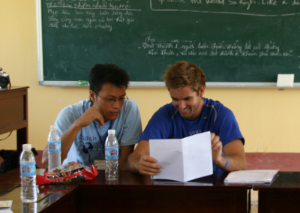
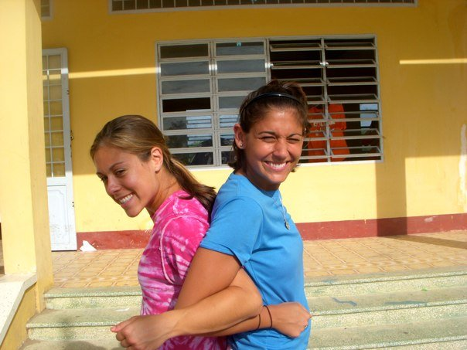
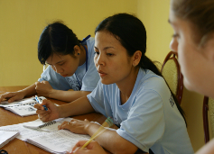
Program Participants
Coach for College contains four types of participants:
Middle School Youth
College Student Directors
American Student Athlete Coaches
Vietnamese College Student Coaches
Notes:
Middle School Youth
The participants targeted for the camps are rising 6th, 7th, 8th, and 9th graders from partner middle schools in low-income, rural communities in developing countries where very few people have obtained a higher education
The participants in the summer 2011 program will be middle school students from one of eight schools in Vietnam’s Hau Giang Province, four schools in the Phung Hiep District and four in the Long My District
For summer 2011, the program will seek to select 96-120 students from a single grade for each three-week camp
College Student Directors
In each three week camp, leadership is provided by college students who participated in the program the year before
They serve as a liaison between American student-athletes/Vietnamese college students and all others involved in the program
Directors help American coaches successfully adjust to the food and living conditions at the camp site
They lead nightly meetings with American student-athletes and Vietnamese coaches and give daily feedback to college student coaches about how to improve their coaching and teaching
American Student Athlete Coaches
The American student-athletes' primary role is to provide expertise on sports and the way they relate to academics and doing well in school, particularly with regards to accessing higher education
They show the youth how to translate lessons learned from sports into success in the classroom, and are able to draw from their own experience in academics and competitive sports to demonstrate how the same skills needed to go far in sports can be used to go far in education
Student-athletes from any varsity sport, from any ACC school and any year in school are eligible to participate
Vietnamese College Student Coaches
All of the college students either attended or have graduated from a university near the partner middle school - They serve as good role models for the students because they are from similar backgrounds, have overcome obstacles (such as lack of money to pay for college) similar to the ones the youth will face on the path to higher education, and have achieved the educational goals the program aspires for the youth to attain
The preference is for Physical Education, English, and English Education Majors. The Vietnamese college students play a crucial role in linking the American student-athletes with the Vietnamese middle school youth through translation

Slide 8
Program Goals
Leveraging Sports to Enhance Academic Outcomes
Translating Academic Success Into the Attainment of Higher Education
Reduce the school drop-out rate in low-income, rural communities in Vietnam by using sports to help youth develop the motivation to stay in school.
Increase in the numbers of youth from low-income, rural communities who attend university
Goal | Middle School Youth | College Student Coaches
1 | Access to Sports Infrastructure and Equipment | Improved Teaching and Coaching Skills
2 | Increase in Sports Enjoyment and Proficiency | Improved Leadership Skills
3 | Increased Critical Thinking and Ability to Apply Knowledge | Increased Cultural Competency and Expanded Worldview
4 | Increased Excitement for and Interest in Academic Subjects | Increased Self-Understanding and Awareness
5 | Development of Life Skills Necessary for the Attainment of Educational Goals | Increased Self-Confidence and Self-Efficacy
6 | Increased Desire For and Confidence In Ability to Attain Higher Education and Career Goals | Increased Commitment to Helping the World’s Poor

Slide 9
The camp schedule
 | SUN | MON | TUES | WED | THURS | FRI | SAT
Week 1 | Registration, Orientation | Class | Class | Class | Class | Tests & Competitions
Week 2 |  | Class | Class | Class | Class | Tests & Competitions
Week 3 |  | Class | Class | Class | Class | Tests & Competitions | Tests & Competitions
Week 4 | Awards Ceremony
Morning Grade 8 (or 6) | Sport | Class | Sport | Class | Life skills | Team bonding, Test review
Lunch
Afternoon Grade 9 (or 7) | Life skills | Class | Sport | Class | Sport | Team bonding, Test review
Dinner and lesson planning
Notes:
The Coach for College program consists of thee-week summer camps taught by teaching teams of American college athlete and Vietnamese college student volunteers. Each camp is designed for different middle school grade (rising 6th – 9th graders) and requires four hours of daily attendance. Vietnamese middle school students are organized into teams of 12-15 students. During the week, they complete sports, academics, and life skills classes, and at the end of each week, the teams compete against each other through team-based sports competitions and individual Academic and Life Skills tests. At the end of the camp, awards are given to the winning team and to the highest scoring students on the academic and life skills tests.

Slide 10
Health Guidelines
Prior to participating with Coach for College it is required that you go to your Campus Health Services or to your personal physician and let them know that you are going to Vietnam. They will inform you of the required and recommended shots and immunizations, as well as prescriptions for travel medications. To maximize safety during the camps, you will be asked to provide CFC with a record of vaccinations and prescriptions received.
Vaccinations
Follow the recommendations of the travel health professional you meet with.
For more information about specific maladies, and ways to prevent them, please consult the websites for the Centers for Disease Control, the World Health Organization, and your personal physician
- WHO Viet Nam https://www.who.int/countries/vnm/
- CDC Southeast Asia http://www.cdc.gov/travel/seasia.htm
Prescriptions
Ask if the doctor or travel health professional you meet with recommends a prescription for any antibiotics to bring with you.
If you are on any prescription medication, you should bring enough for the duration of your stay, as medications may not be sent via mail
People who wear contacts should remember to bring a pair of glasses, eye drops, and saline solution (for preferred brands)
You must set up and attend a health appoint with your Campus
Health Services or personal physician by April 20th at the latest

Slide 11
Fundraising Guidelines
You are required to complete your fundraising by one week prior to departure for camp, at which point you are responsible for transfering any shortfall, to reach the full amount.
Recording Donations
We have our own fundraising platform where you can create your personal fundraising page – you can access this page off of the Coach for College website (www.coachforcollege.org), clicking on the “Participant Fundraising” button and finding your name
Strategies
General Advice
Send emails, letters and social media messages to family, friends, members of your team and their families, organizations that you are involved with (fraternity / sorority, church, etc.)
Be sure to direct potential donors to your donation webpage
You can use the template or write your own letter, but be sure to include information about the program and why you think it is important that you participate
Direct potential donors to the website and videos in order for them to learn more about the program
Pitch an article to your hometown newspaper, explaining the program and the case for support
Try to focus on getting a lot of small donations rather than a few large ones
Remember: whenever you are fundraising be sure you are asking for money for the program generally, NOT to fund your personal trip
If you don’t hear back initially after you send a letter or an email, try following up by phone or by meeting with someone in person
Try to coordinate with other coaches at your school to do a joint fundraiser and split the money earned (ex. partner with a restaurant or entertainment venue near campus and host a charity night in which all cover goes towards CFC)
Remind people of how far a little amount of money goes in Vietnam

Slide 12
IMPORTANT: Pre-departure forms
Participation Agreement – emailed from us
Terms & Conditions – emailed from us
Medical history form – https://forms.gle/BBq3FtAzhvjCPkBu7

Slide 13
Next Steps
Research and discuss travel plans ASAP – The goal is to have all flights booked by the end of April.
If you change your mind after the flight has been purchased, you would be financially responsible for any changes.
Get to know the other members of your team! Teams often set up an email chain or a Facebook group, to be in contact before arriving in Vietnam.
Continue fundraising efforts!
Contact us if you have any questions!

