Slide 1
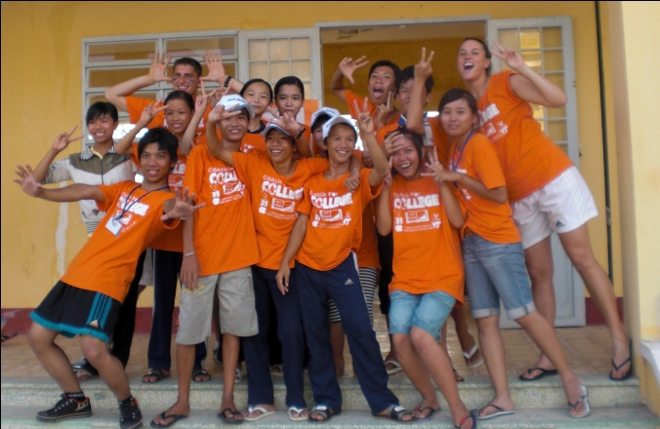
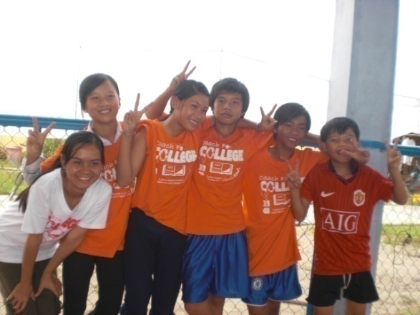
Session 5: Preparing to Coach

Slide 2
Agenda
Being Effective Coaches: Teaching | 3
Being Effective Coaches: Coaching | 4
Key Vietnamese Language Phrases for the Program | 7

Slide 3
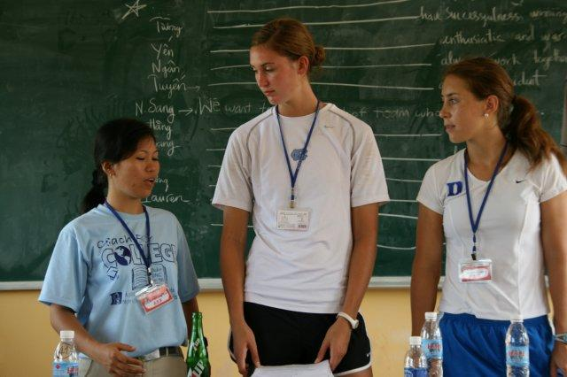
Being Effective Coaches: Teaching Vietnamese Youth
These are key principles that you should keep in mind in order to be an effective teacher and coach
Vietnamese Learning Style
Meticulous note-taking
Formalized lesson outline
Quiet learning environment
Wait to be called on to answer
Immense respect for education
Balance respect for students and discipline
Secrets of Successful Teaching
Your leadership as a teacher is critical.
Model effective leadership.
Pay attention to group dynamics.
Use your own style and expertise.
Ask open-ended questions.
Understand the camp dynamic.
Participate in the learning process.
Plan personal time.
Notes:
Vietnamese Learning Style
*Be sure to communicate and rely on your Vietnamese college student counterparts
Meticulous note-taking: Vietnamese students often scribe information directly from the board. Work with your Vietnamese college counterparts to decide the proper detail of information to note on the board.
Formalized lesson outline: While you shouldn’t “teach to the test,” the student versions workbooks are there to provide a structured outline, much like the student typically learn with while in school. Rely on the book to guide your teaching.
Quiet learning environment: Most Vietnamese classrooms are quiet learning environments. Don’t be distracted by the student’s attentiveness or lack of direct response.
Wait to be called on to answer: Vietnamese students will often wait to be called on the give an answer. Don’t necessarily interrupt your classes’ lack of raised hands as a lack of understanding. Try calling on a student to see if they understand and then helping them work through the answer if they don’t get it correct initially.
Immense respect for education: The Vietnamese, like most Confucian cultures, have an immense respect for education and teachers. Try to convey this reinforce this respect by keeping the classroom a formal setting. Stand up to teach. Don’t sit on the desks. Demand attention from your students while you teach.
Balance respect for students and discipline: Despite the need to keep the educational setting formal, we aren’t their teachers. Try to balance discipline by creating fun and engaging activities for the students. Don’t belittle them and always show respect for cultural norms (e.g. not touching student’s heads, not pointing the bottoms of your feet towards any students).
Secrets of Successful Teaching:
Your leadership as a teacher is critical. But to be successful, you must also have at least one person on your "team" of youth, if not a few, who can effectively lead their fellow teammates.
Model effective leadership. Youth will learn infinitely more about leadership by your actions than by what you preach to them. Be sure you are just as demanding of your own leadership skills as you are of the youth.
Pay attention to group dynamics. Every team/class has to be coached slightly differently.
Use your own style and expertise. Follow the content of the curriculum, but use your own style and expertise to add 'texture“ to the material. This is not a rigid curriculum but meant to be fluid and alive. Use examples and personal stories wherever you can.
Ask open-ended questions. Get into the habit of asking open-ended questions where appropriate; then make sure you give people enough time to respond. Always acknowledge participants' answers and opinions.
Understand the camp dynamic. Realize that the intensity and emotional level of the camp increases as time goes on. Include icebreakers or other quick experiential activities when you sense a decline in momentum, especially as the week moves on and participants are getting tired.
Participate in the learning process. Use these three weeks as a time of risk taking and growth for yourself. The more you personally participate in the learning process, the more effective your coaching will be for the participants.
Plan personal time. Use it for reflection, rest, and feedback.

Slide 4
Being Effective Coaches: Coaching Vietnamese Youth
These are key principles that you should keep in mind in order to be an effective teacher and coach
Tips from great coaches
Take your role seriously --- but not too seriously
Enjoy getting to know your kids
Be comfortable with being in charge
Desire to help kids learn and grow
Be dependable and stable
Be an encourager
Be patient
Be willing to learn
Be flexible
Have a sense of humor
Secrets of Successful Coaches
Character-based - credible coaches are people of great character
Competent - credible coaches know the strategies and skills of their sport
Committed - credible coaches have a real passion for coaching
Caring - credible coaches care about their kids as people
Confidence builder - credible coaches help kids feel good about themselves
Communicator - credible coaches communicate and listen well
Consistent - credible coaches have consistent philosophies and moods
Notes:
Tips from great coaches:
Take your role seriously --- but not too seriously
Be comfortable with being in charge
Be dependable and stable
Be patient
Be flexible
Enjoy getting to know your kids
Desire to help kids learn and grow
Be an encourager
Be willing to learn
Have a sense of humor
Secrets of Successful Coaching
Character-based - credible coaches are people of great character
Competent - credible coaches know the strategies and skills of their sport
Committed - credible coaches have a real passion for coaching
Caring - credible coaches care about their kids as people
Confidence builder - credible coaches help kids feel good about themselves
Communicator - credible coaches communicate and listen well
Consistent - credible coaches have consistent philosophies and moods

Slide 5
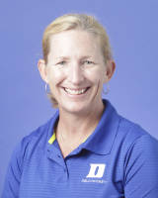
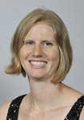
Being Effective Coaches: Coaching Vietnamese Youth
Keys to Conducting a Great Practice
Personal Experience: Our Coaches
1
Players' Focus.
Think about your past and present coaches. Reflect on the best coach you’ve ever had. What made them have such a strong effect on you?
2
Name that Skill
3
Skill Context
4
Show and Tell
5
Practice the Skill
6
Provide Feedback
Notes:
Keys to Conducting a Great Practice
Players' Focus: When you explain a skill or drill to your team, first make sure you have everyone's attention.
Name That Skill: When you have their attention, identify the skill or tactic you are going to teach.
Skill Context: Make sure to put the skill or tactic into context for the players. Let your players know how the team benefits when the skill or tactic is correctly executed.
Show and Tell: A verbal explanation is not enough. Make sure you briefly explain the skill as you demonstrate it. Show the skill a few times. Break the skill into parts, showing each part first and then showing the complete skill without a break.
Practice the Skill: After you've introduced a skill and shown and told your players how to perform it, have them practice the skill in game-like situations. Use drills or games that simulate the experiences they will have in competitions and observe their techniques
Provide Feedback: As players take part in a drill or a game, practicing the skill or tactic you've just taught them, observe their execution and be ready to provide feedback to help them correct their errors and improve their play.

Slide 6
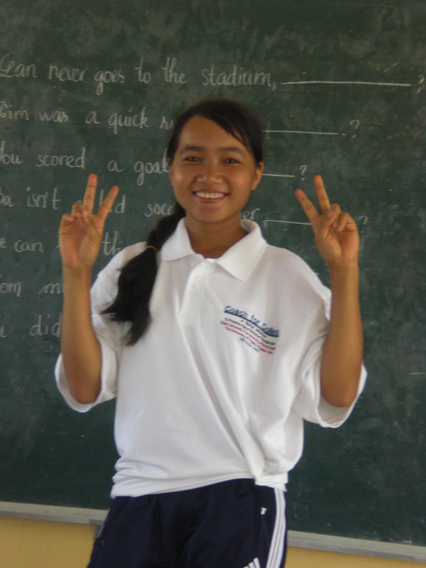
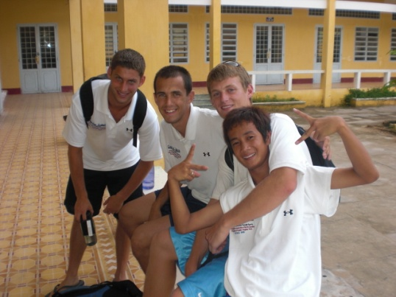
Being Effective Coaches: Working with Vietnamese College Students
A key component of the program is bridging the cultural gap between yourselves and your peer Vietnamese coaches. Below are some tips for helping to build and maintain that relationship:
Be friendly and open-minded.
Demonstrate patience and speak slowly
Discuss the lesson plans thoroughly.
Ask if they have questions.
Get to know them on a personal level
Include them in evening activities.
Ask about cultural differences and norms.
We highly recommend taking some time before leaving for Vietnam to make a list of (fun) drills to teach the basics of the sport you will be teaching.
It may be useful to search for some ideas on the internet before leaving, as well. Relays and competitions focusing on a fundamental skill are also good, particularly on the first two competition days.
Notes:
A key component of the program is bridging the cultural gap between yourselves and your peer Vietnamese coaches. Below are some tips for helping to build and maintain that relationship:
Be friendly and open-minded. Remember that they are coaches as well – not just “your translators”
Demonstrate patience and speak slowly.
Discuss the lesson plans thoroughly. Review the actual lessons nightly. This will ensure that the Vietnamese coaches understand what you are explaining and can appropriately translate.
Ask if they have questions. Thoroughly answer the ones that they have and seek to collaborate on the best ways to deliver the material.
Get to know them on a personal level. Tell them about yourself and ask them about themselves. This is the quickest way to cultural interaction.
Include them in evening activities. Play cards, watch movies, and engage in weekend activities not just with your fellow American coaches but with your Vietnamese counterparts as well.
Ask about cultural differences and norms. Understand anything you should be aware of and work to find solutions that respect both your comfort and their traditions. A simple conversation may be enough to resolve an issue that may cause a loss of face for both parties later on.

Slide 7
Key Vietnamese Language Phrases for the Program
Below are some common sports-related words and phrases that will be helpful to learn when you are at the camps. Learning a few key Vietnamese words and phrases is both fun and useful, and the kids respond enthusiastically to even a few words. You should also ask your Vietnamese coaches to help you learn some basic instructional phrases.
Soccer
English | Vietnamese
Soccer | Bong da
Coach | Huan luyen vien
Goal keeper | Thu mon
Goal | Khung thanh
Goal area | Khung cau mon
Corner kick | Cu da phat goc
Dribble | Cu re bong
Foul | Loi
Kick | Cu da
Offside | Viet vi
Shot | Cu sut
Volley | Cu vo le
Dribble (v.) | Lua bong
Kick (v.) | Da
Pass the ball | Chuyen bong
Score a goal | Ghi ban
Shoot (v.) | Sut
Tennis
English | Vietnamese
Tennis | Quan vot
Tennis player | Ngubi denh tennis
Base line | Duong bien cuoi san
Break point | Diem thing
Deuce | Hoa deu
Game | Van dau
Service | Cu giao bong
Set | Xet dau
Tennis ball | Bong tennis
Tennis court | San tennis
Tennis match | Tran dau tennis
Tennis net | Luoi
Tennis racket | Vot tennis
Volley | Cu vo le
Serve (v.) | Giao bong
Basketball
English | Vietnamese
Basketball | Bong ro
Backboard | Tam bang sau cai ro
Basket | Cai ro
Dribble | Da bong
Free-throw line | Duong bien nem tu
Foul | Loi
Free throw | Cu nem tu do
Field goal | Ban thang ghi hai diem
Guard | Hou ve
Defend (v.) | Phong thu
Volleyball
English | Vietnamese
Volleyball | Bong chuyen
Net | Luoi
Referee | Trong tai
Service area | Khu phat pong
Volleyball court | San bong chuyen
Notes:
You are by no means required to know these words, especially since knowing how to pronounce them is difficult until you actually hear the words from the Vietnamese coaches who will be helping you learn. While we highly encourage you to throw yourself into the fun of learning and using many words and expressions while you are in Vietnam, you are not expected to know any ahead of time. This is purely an aid that you can use and refer to once in Vietnam.

